Slide 1
College of Arts and Sciences, Office of Advancement
Advancement Overview for Chairs, Directors, and Fiscal Officers

Slide 2
College of Arts and Sciences Office of Advancement
Key Objectives
Develop an appreciation for, and ways to build, a donor-centered culture.
ID specific and actionable ways you can work with our
office to advance your priorities.
Advancement 101

Slide 3
College of Arts and Sciences Office of Advancement
Office of Advancement
Maximize philanthropic support through a donor-centered culture that advances the College’s mission and priorities.
Grow trust among stakeholders
Celebrate achievements
Inspire pride and commitment

Slide 4
College of Arts and Sciences Office of Advancement
Last Year’s Points of Pride
Launched the College’s first impact report.
Deep dive education sessions on donor stewardship, alumni communications, and annual giving.
Advancement quarterly.
Surpassed fundraising target – over $27 million committed from more than 4,500 donors!
Most successful IU Day ever!
Notes:
More than $41k raised from 149 donors on IU Day
$27 million includes deferred, endowments, pledges, and cash.

Slide 5
Donor-Centered Fundraising
How would you define a donor-centered fundraising culture?

Slide 6
College of Arts and Sciences Office of Advancement
Donor-Centered Fundraising
Integrated and collaborative approach to raising more money that inspires donors to remain loyal longer, to make more generous gifts, and to shift their giving from modest to generous sooner.
Personalize the experience.
Identify what donors want to accomplish through philanthropy.
Donor-centered golden rule: treat each donor as they want to be treated.
Notes:
It’s about each donor, not the dollars.
Underscore an example of personalization, in the case, for instance, a faculty colleague donates. Include some short note that demonstrates the letter was personalized for them.

Slide 7
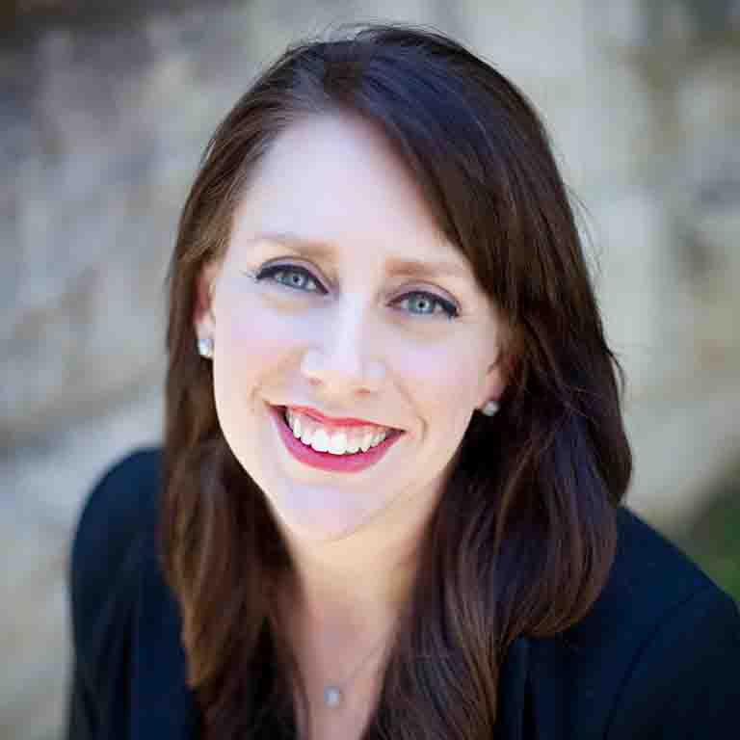
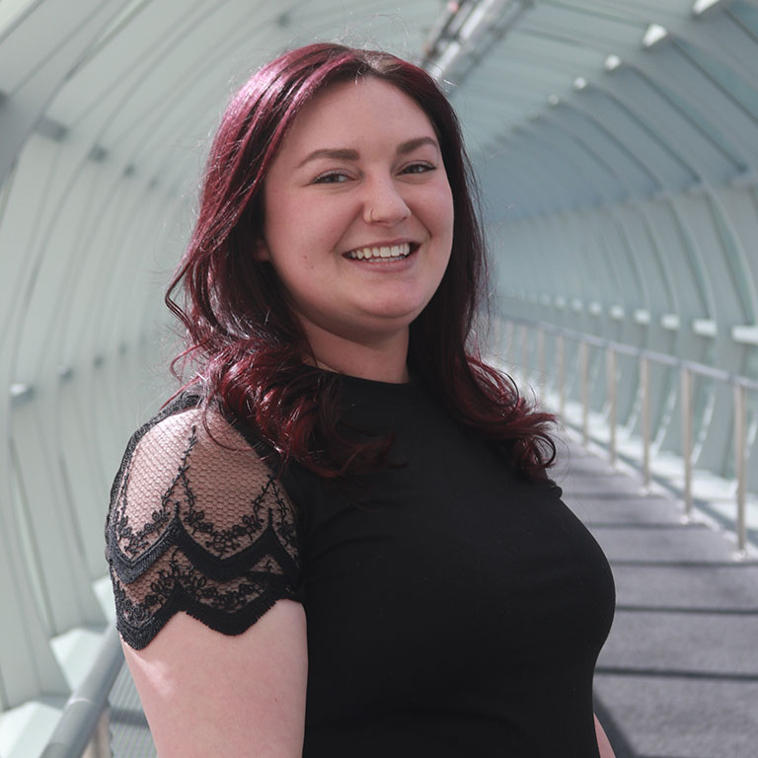
Alumni Engagement
Communications – Recognition – Programming – Volunteering
Vanessa Cloe, Director of Alumni Engagement
Haley Russ, Associate Director of Alumni Engagement

Slide 8
College of Arts and Sciences Office of Advancement
Historically …
Friend-raising and fundraising have operated independently … but not going forward.
We want our alumni to feel proud, but we must remain focused on goals and priorities.
Strategic prioritization of our limited resources.
Productive engagement is purposeful and aligned with building trust and maximizing philanthropic support.
Notes:
Alumni engagement for the sake of engaging alumni is not the objective.
Goals can include engaging alumni to help students, for instance, but engaging alumni just to increase engagement rates is not the objective.
This is aligned with the IUAA and the IUF, who are partnering on a strategic plan.

Slide 9
College of Arts and Sciences Office of Advancement
We need your help!
179,319 living alumni and only about 81,000 contactable by email.
Request updated info when you communicate with alumni.
Add a “share your story” feature to your website.
Consider a link in your signature line.
Involve faculty members when reviewing alumni lists.
College’s Alumni Update Form: go.iu.edu/8qD5
Notes:
Alumni have the greatest affinity to their academic unit (You!)
Request updated contact info from alumni when you communicate with them and provide it to our office.

Slide 10
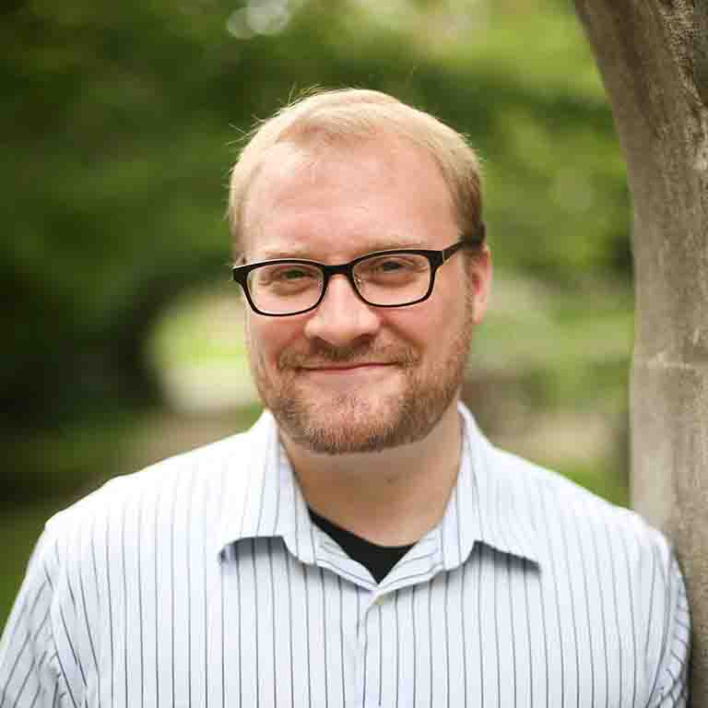
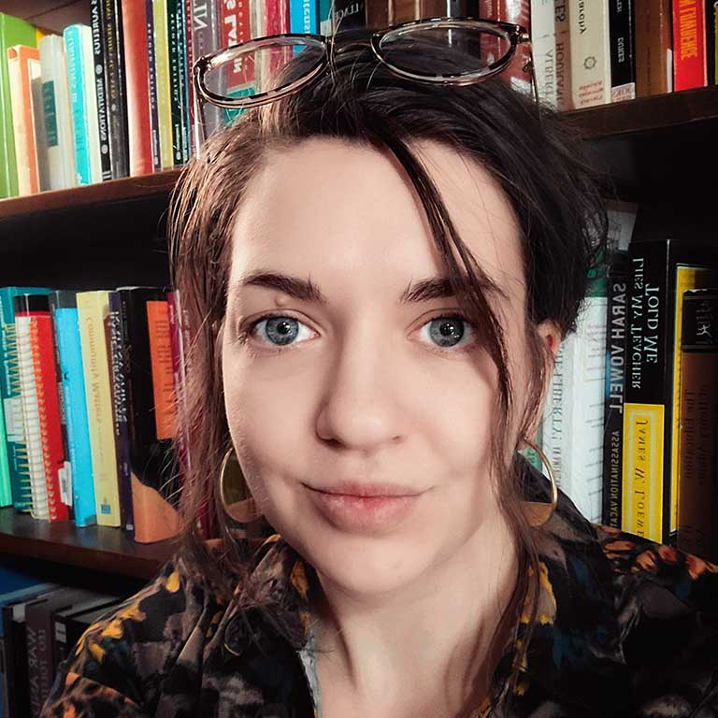
Alumni Communications
Raymond Fleischman, Director of Adv. Communications
Sarah Johnson LaBarbera, Associate Director of Adv. Communications

Slide 11
College of Arts and Sciences Office of Advancement
What do alumni want?
Good news - alumni want to hear from you!
Consistent communications, and not necessarily lengthy.
Students, faculty, alumni, and news that will inspire pride.
Notes:
Our research shows that alumni are more interested in hearing from their home department or program than the College in general. As Raymond and Sarah would put it, our engagement scores are higher when mailers are sent from academic units.
Consistent could mean twice a year, or for some it might mean four times a year. But our research shows that long communications just don’t engage folks as well.

Slide 12
Think Differently
Draft a brief article about a student, alum, or faculty member, embed it on your news page, and we'll send it to your alumni from you. No lengthy newsletter required.

Slide 13
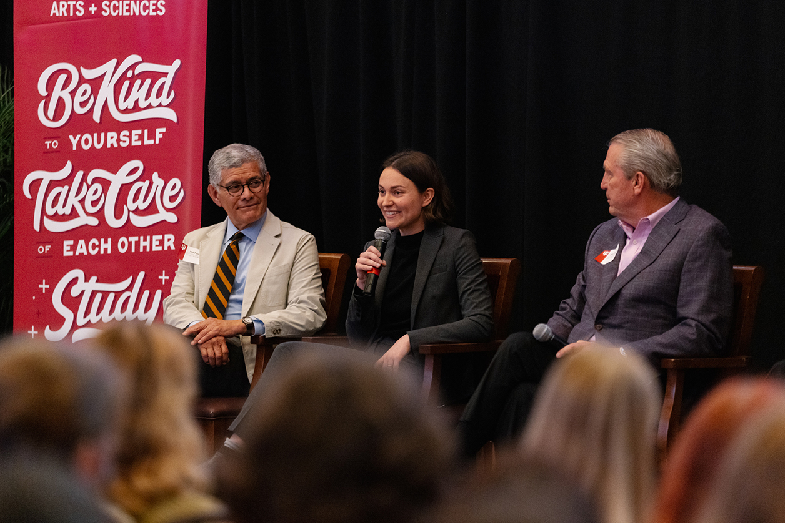
College of Arts and Sciences Office of Advancement
Alumni Recognition
Nominate alumni for awards and encourage
attendance at ceremonies
Celebrate alumni accomplishments
Notes:
Consider university opportunities like Distinguished Alumni Service Award, College opportunities like the Distinguished Alumni Award, and consider one for your academic unit.
Celebrating alumni can be accomplished many ways, such as the College’s 20 under 40, the College’s alumni spotlights, and including a writeup about their accomplishments in your communications.

Slide 14
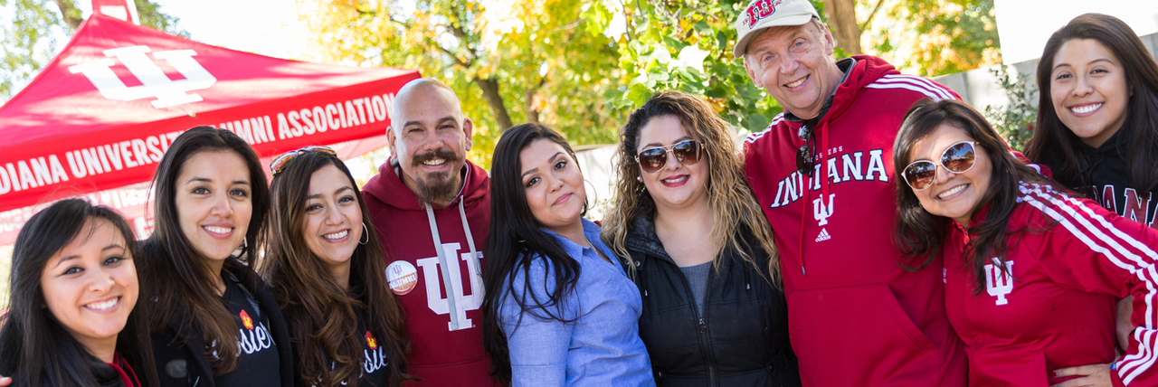
College of Arts and Sciences Office of Advancement
Alumni Programming
Milestone Anniversaries
College funding available for your activities and programs
Online Programs
Lectures
Academic Conferences
Notes:
Is your academic unit turning 50? That’s a great time to coordinate a gathering.
Pandemic blessing – virtual programming like Food for Thought…great opportunity to engage alumni around the world!
Reference McNutt lecture as a great example of alumni engagement, leading to Peter Goodman’s philanthropic support.
Do you have an annual conference where you could invite alumni to a reception or a meal?
Up to $2,000 available for most programs. There’s a simple form online you can complete on our website.

Slide 15
College of Arts and Sciences Office of Advancement
Alumni Volunteerism
Walter Center Career Success Network (online)
Connect Conference (spring)
Classroom/conference speaker (please let us know)
Internships
Notes:
Low barrier (WCSN) through most engaging (ID alumni to offer internships).

Slide 16
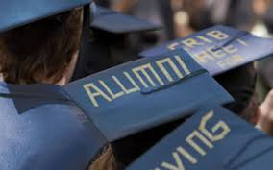
College of Arts and Sciences Office of Advancement
Why do alumni and friends become donors?
Feeling of loyalty and appreciation; to pay it back.
Advance shared values and fulfill an area of passion.
Tax advantages.
Memorable faculty relationships.
Someone asked them to give.

Slide 17
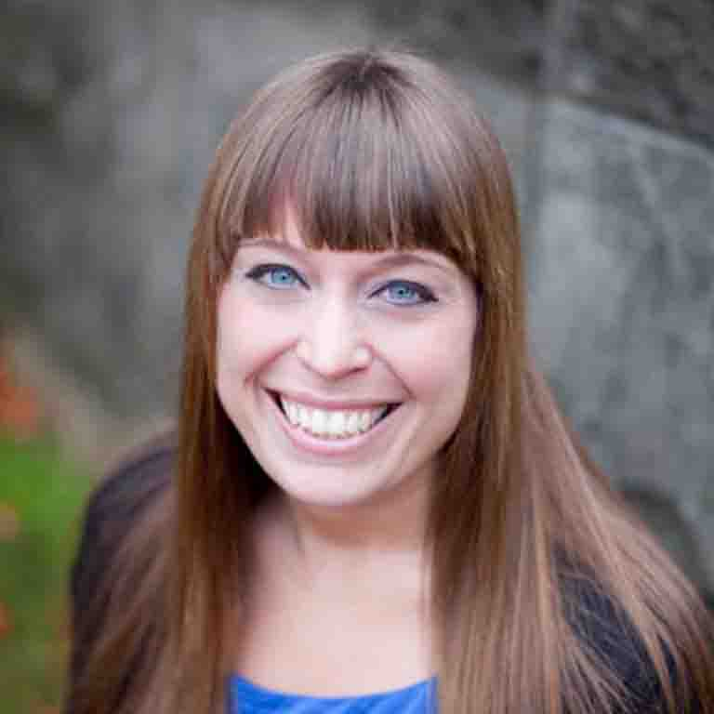
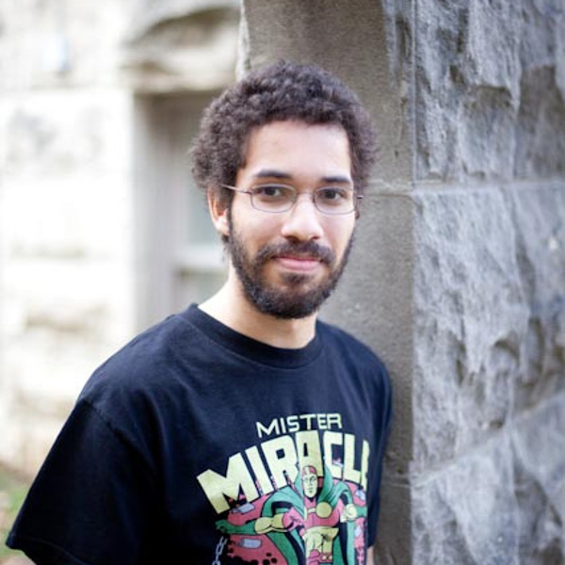
Donor Stewardship
Gift Acknowledgement and Impact Reporting
Gillian Johnston, Director of Annual Giving & Donor Relations
Matt Herndon, Associate Director of Annual Giving & Donor Relations

Slide 18
College of Arts and Sciences Office of Advancement
Why do donors continue to give and increase their giving?
A donor needs to know…
That the gift was received, and you were pleased to receive it.
That the gift will be used as the donor intended.
That the project or program to which the gift was
directed had/is having the desired effect.
Notes:
How the gift is set to work should be narrower in scope than the mission as a whole.

Slide 19
What the research says…
93% would definitely or probably give again the next time they
were asked if that nonprofit provided them with meaningful
information on their gifts at work!
64% would definitely or probably give more!
74% would continue to give indefinitely as long as they received
meaningful information!
Fundraising Effectiveness Survey , AFP

Slide 20
College of Arts and Sciences Office of Advancement
Acknowledging a Gift
What is already being done?
Bi-weekly acknowledgments from Executive Dean
First-time donor acknowledgment, 30-day check in, and annual check in
IUF gift receipts and endowment reports (once per year)
Personal visits from gift officers and sometimes department & College leaders

Slide 21
College of Arts and Sciences Office of Advancement
Acknowledging a Gift
A few tips for timely, focused, and personal thank you letters.
Personal salutation (no “dear donor” or “dear friend”).
Make specific reference to the intended use of the funds.
Communicate excitement, gratitude, and the inner warmth of the writer.
Grab the reader’s attention in the opening line.
Do not ask for another gift!
Concise – no more than a few paragraphs.
Penelope Burk, Donor Centered Fundraising
Notes:
Each month Matt shares your gift information and you have the opportunity to thank your donors. I know many of you do a tremendous job with this – thank you!
Here are a few of my favorite ways to enhance your thank you letters.
What you did was exceptional. Because of you…
You are my hero. Yes, you. Not only do you value the education you received, you’re paying it forward.
There’s about 20 other research-proven ways to improve them, and you can learn more by searching online for donor centered acknowledgment letters.

Slide 22
Impact Reporting
Demonstrating how philanthropy is advancing our mission and goals.

Slide 23
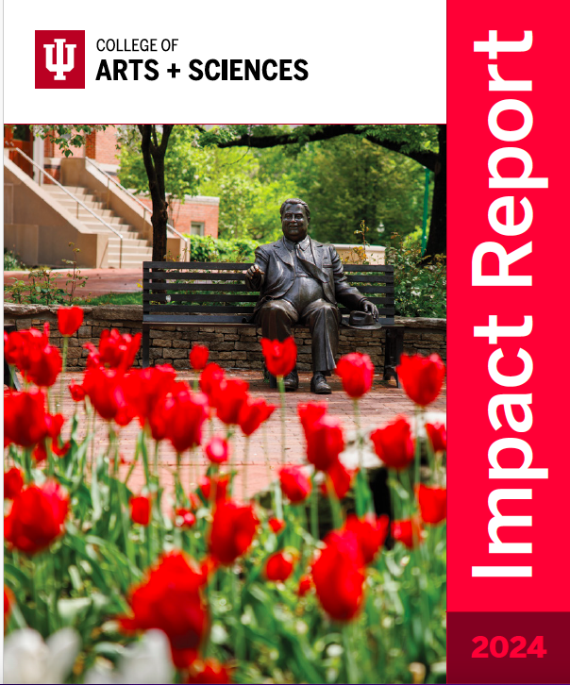
College of Arts and Sciences Office of Advancement
Impact Reporting
What is already being done…
Annual impact report
Impact Report
Mini-impact updates throughout the year
Scholarships, fellowships, and faculty endowments

Slide 24
College of Arts and Sciences Office of Advancement
Demonstrating Impact
What you can do…
Use funds appropriately and timely.
Weave impact information into communications.
Share information for donor packets.
Provide updates for the College’s impact reports.
Notes:
Abide by the donor intent.
A few times a year Gillian will request your support for donor packets – please prioritize those!

Slide 25
Annual Giving Program
Partnership between the IU Foundation AG Team and the College’s Advancement Team

Slide 26
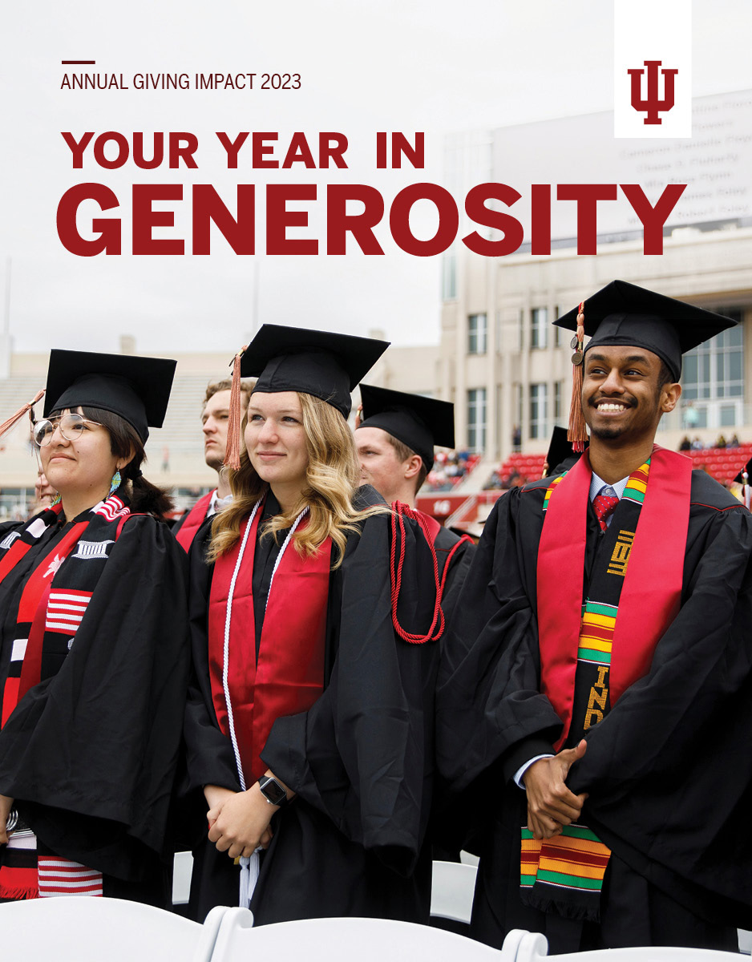
College of Arts and Sciences Office of Advancement
Annual Giving Program
Central Campaigns &
Academic Unit-Owned Opportunities
Central Campaigns Quarterly
Audiences
Active Donors (last gift in FY24)
Lapsed Donors (last gift prior to FY24)
Non donors (alumni and friends)
Notes:
Central campaigns strategies leverage multiple channels (email, direct mail, & social media).
Solicitations are based on giving behavior. If a donor gives to your academic unit, we will ask them to renew their support for your unit.
There are quarterly centralized campaigns through our partnership with the IUF AGP.
It costs about 20 cents to raise a dollar from active donors, about 60 cents to raise a dollar from recently lapsed donors, and it costs about $1.20 to raise a dollar from non donors.

Slide 27
Annual Giving Results
College of Arts and Sciences Office of Advancement
Division | FY23 Giving Under $10,000 | FY24 Giving Under $10,000
Arts & Humanities | $453,756 | $488,002
Centers or Institutes | $15,347 | $49,454
Central College Funds | $441,186 | $426,813
Natural & Mathematical Sciences | $721,405 | $785,301
Social & Historical Sciences | $176,073 | $184,452
 | $1,807,767 | $1,934,022
Notes:
This slide demonstrates how a donor-centered approach is paying off. Donors contributed an additional $150k to our academic units while decreasing their giving for central funds. Donor behavior dictates where we solicit, and we don’t always ask for the College’s unrestricted fund.

Slide 28
College of Arts and Sciences Office of Advancement
Academic Unit Opportunities
Define funding priorities
Do you need unrestricted funds for immediate use?
Scholarships, fellowships, experiential learning?
Crowdfunding opportunities in April (IU Day)
Leverage marketing & engagement
Direct alumni & friends to support funding need
Enhanced Fund Pages
Enhance your giving pages!
Notes:
Help us with your priorities so we can solicit for those needs. Gillian is our director, and she interfaces with the AGP office regularly. She will be in touch with your unit to understand those priorities so we can adjust the specifics of the appeals, if necessary.
Our default is to ask for scholarships, experiential learning, fellowships, and unrestricted.
Crowdfunding in April is the best ways to acquire new donors.

Slide 29
College of Arts and Sciences Office of Advancement
Enhanced Fund Pages
Standard Giving Pages
Generic photo and language from gift agreement
Enhanced Fund Pages
Multiple photos
Short description and a long description
Quote from a donor or beneficiary
You can even embed a video!
https://give.myiu.org/iu-bloomington/I380016521.html
Notes:
The more customized your giving pages the more likely you are to secure increased funding.

Slide 30
College of Arts and Sciences Office of Advancement
What leads donors to consider a major gift?
Personal relationships with faculty and professional staff in the College and at the unit level.
Matching donor interests with needs and priorities – appreciation for the opportunity to express values.
Identifying and executing the best major gift strategy.
Notes:
90% of major gift donors began their journey with a gift under $100.

Slide 31
Development Officers
College of Arts and Sciences Office of Advancement
Jeff Stuckey
Executive Director, Advancement
Josh Lodolo
Senior Director, Advancement
John Armstrong
Director of Development
Pete Rhoda
Director of Development
Gabrielle Sloan
Director of Development
Sue Sgambelluri
Director of Development
\

Slide 32
College of Arts and Sciences Office of Advancement
Coming Soon!
Deep dives on alumni engagement and donor stewardship
Refining alumni communications at the College and unit level
Piloting strategic collaboration with three departments
Faculty endowment stewardship and impact reporting
Mini-impact updates to complement our annual impact report
College Advancement Hub

Slide 33
College of Arts and Sciences Office of Advancement
Recap: How You Can Help
Enhance your giving pages and lean into crowdfunding opportunities
Craft personalized & meaningful donor-centered acknowledgments
Send us your impact updates
Strategically prioritize alumni engagement efforts
Craft a warm cover letter for endowment stewardship efforts
Nominate alumni for awards
Help us improve alumni contact information and let us know when you engage alumni

Slide 34
college.indiana.edu/alumni-giving

