Slide 1
'24
College of Arts and Sciences, Office of Advancement
Unleashing the Power: Annual Giving and Impact Reporting

Slide 2
Key Objectives:
Navigate Annual Giving Best Practices
Shift Focus: Illuminate Impact for Future Support
Empower Departments with Effective Impact Reporting and Alumni Engagement Strategies

Slide 3
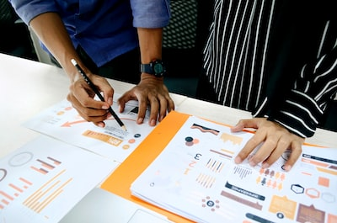
What does the research show?
The IUF Central Advancement Annual Giving structure (donor-centric) supports acquisition, retention, and reactivation of donors to all funds across IU in order to grow the donor pipeline overall (vs. short-term revenue generation for operations.)
1
How much does it cost to raise $1?
What percentage of Annual Gift donors become Major Gift donors?
2
3
Building a sustainable donor base by following the Rule of 7.

Slide 4
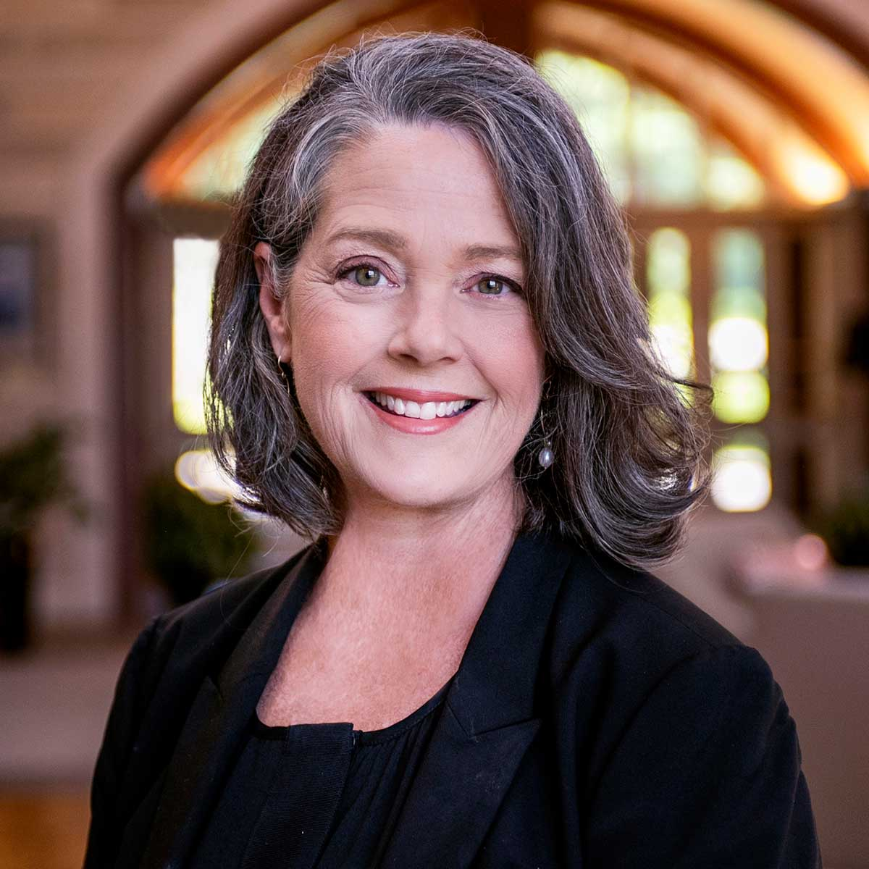
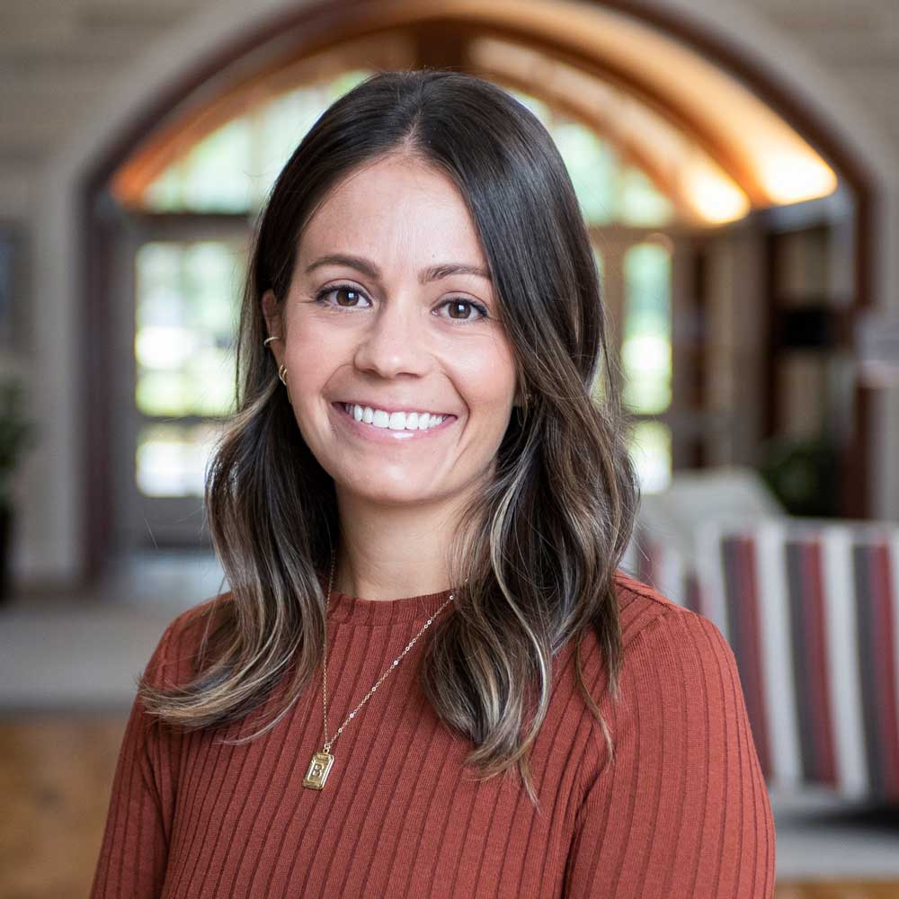
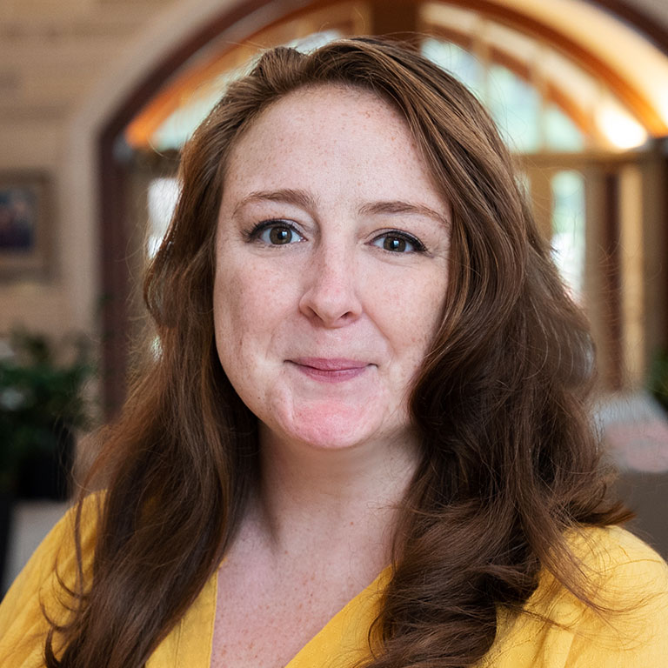
IU Foundation Annual Giving Team
Lindsey Pearsey
Brittany Bauer
Sarah Ericson
Associate VP, Annual Giving & Market Segmentation
Associate Director, Annual Giving Strategy
Annual Giving Account Manager

Slide 5
Opportunities to engage your alumni and donors directly
Newsletters
Give Now Buttons
Events
Special Occasions
Giving Tuesday – December 3, 2024
IU Day – April 17, 2024

Slide 6
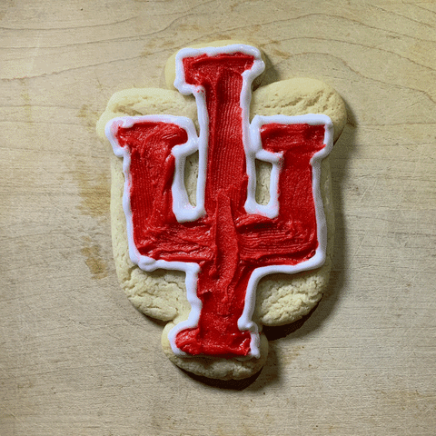
IU Day - April 17, 2024
For groups who obtain a lead gift of $500+, the IU Foundation will contribute an additional $500 (max.).
Once your match/lead gift details are figured out in coordination with the Office of Advancement, please email iuday@iu.edu with this information:
• Gift amount
• Account it will support
• Details of incentive/match
• Donor name(s), only if they want to be recognized
Don’t forget the due date:
All requests (crowdfunding, lists, data, etc.) are due in Workfront no later than March 1.

Slide 7
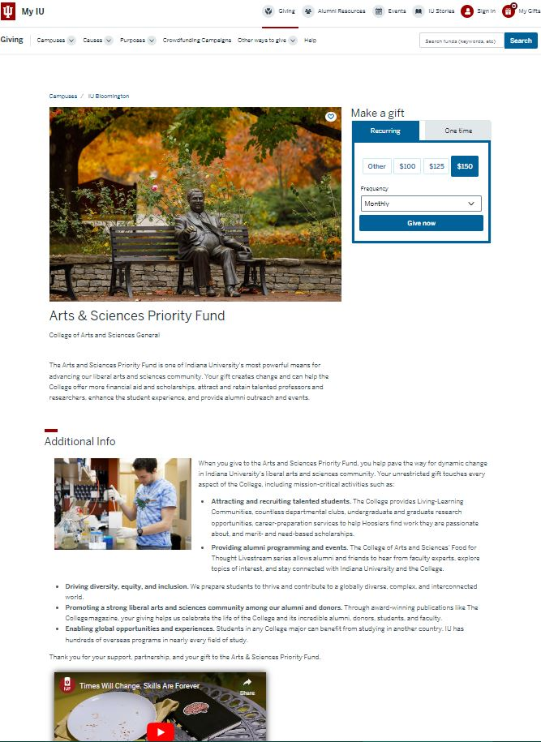
Enhanced Fund Pages
Enhanced Fund Pages (EFP) are funds that are visible/publicly searchable on myiu.org.
These include:
Accounts established for solicitation purposes (multi-donor)
Accounts where the donor has released it to receive additional donations

Slide 8
Impact Reporting
Showing how donations are used to make an impact

Slide 9
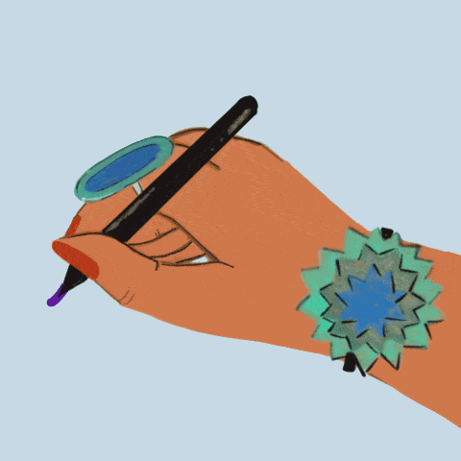
What do donors want?
They want to be recognized.
They want transparency and to be shown the impact of their gift.
They want to feel appreciated.

Slide 10
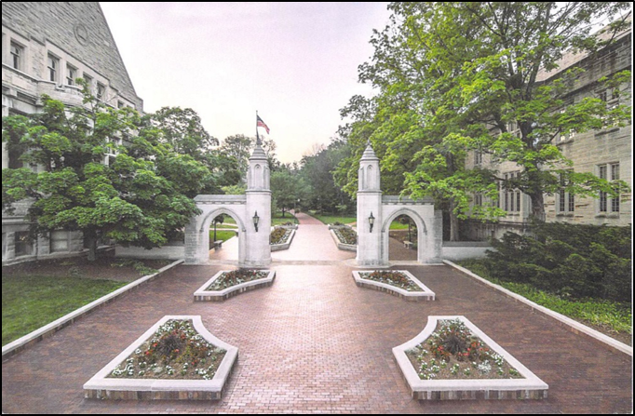
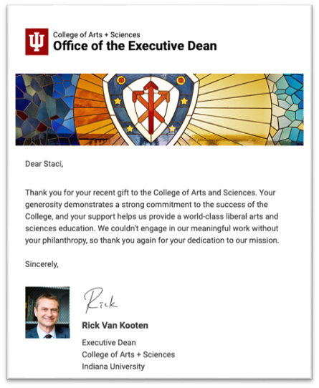
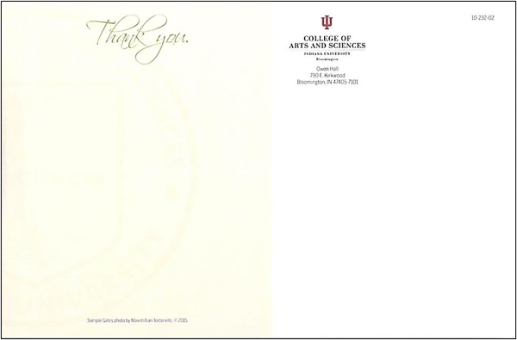
They want to be recognized
Express Gratitude for their contributions promptly.
Highlight donors and alumni in your newsletter or on your website - with their permission, of course!
Invite them back for your awards banquet.

Slide 11
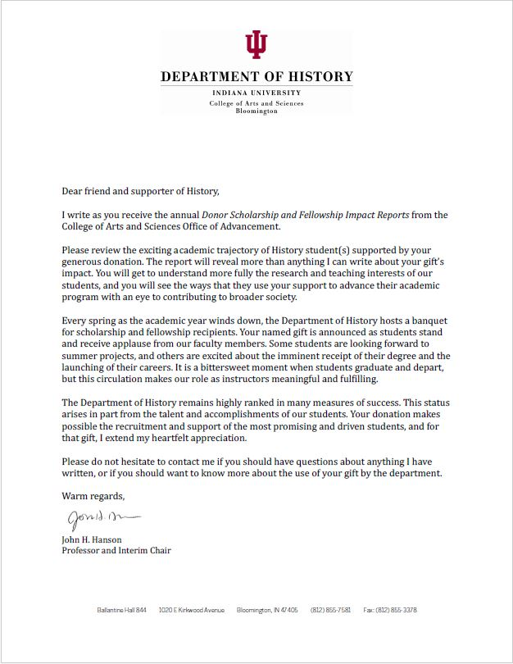
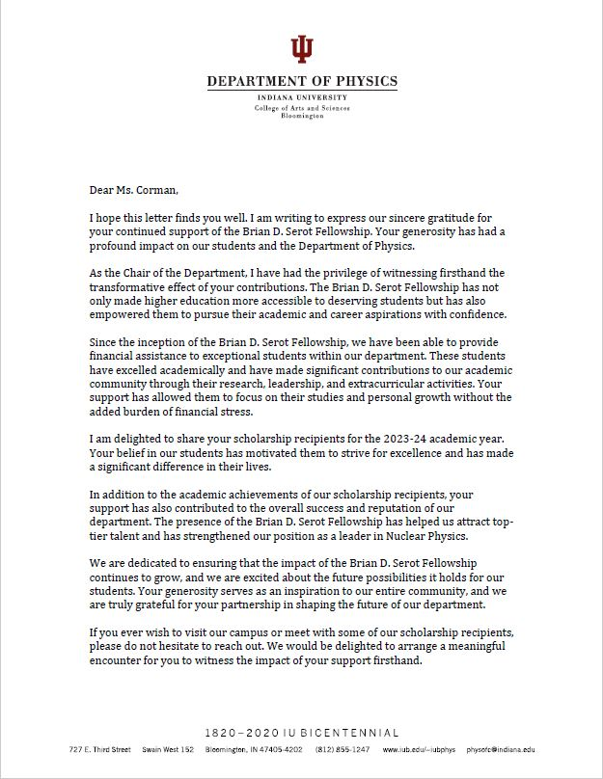
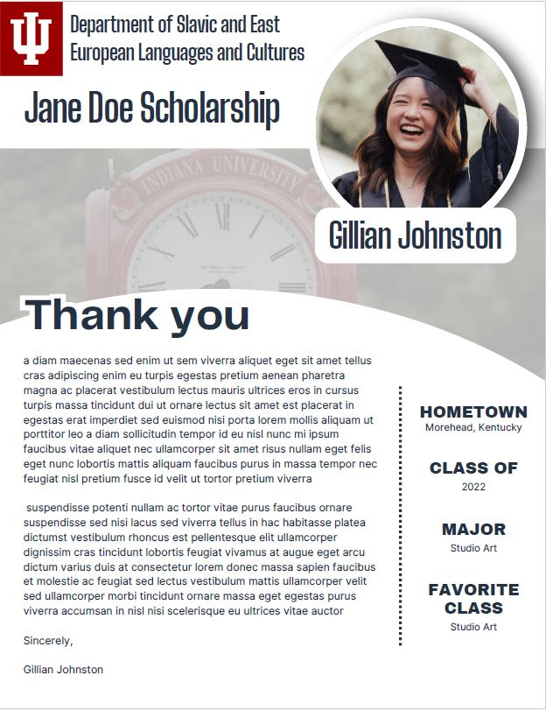
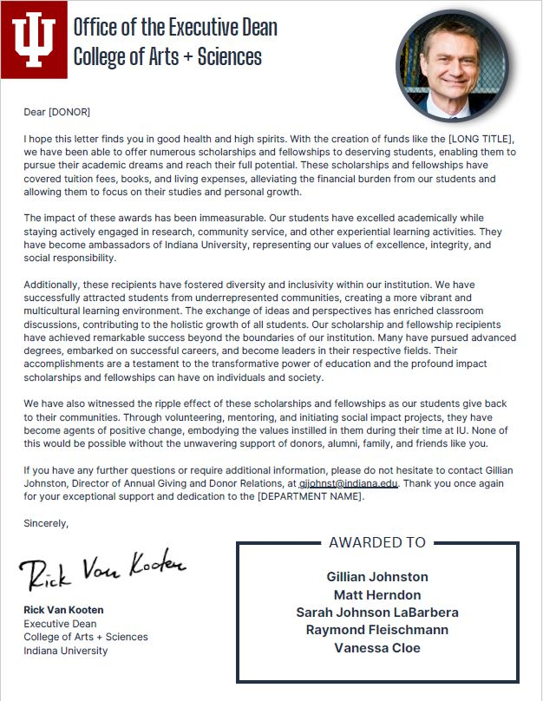
They want transparency and to be shown the impact of their gift.
Transparency is key. It is not just about reporting on what has been done but also about communicating our plans and strategies.
Enhance your connection by making it personal.
Share updates by adding a cover letter to the scholarship and fellowship donor packets.

Slide 12
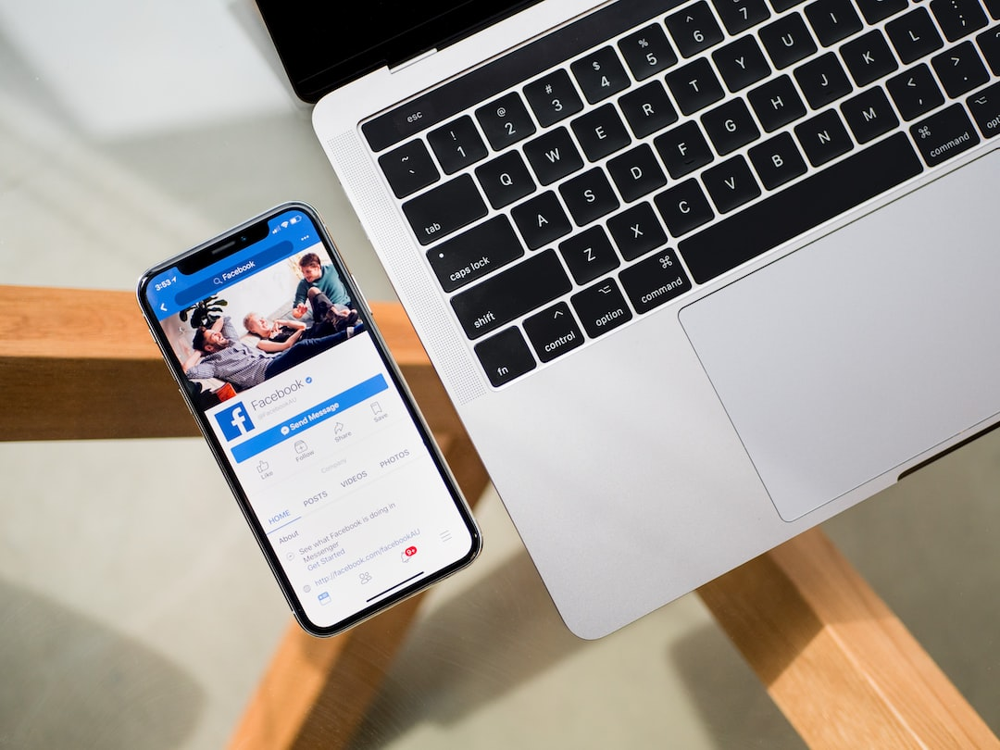
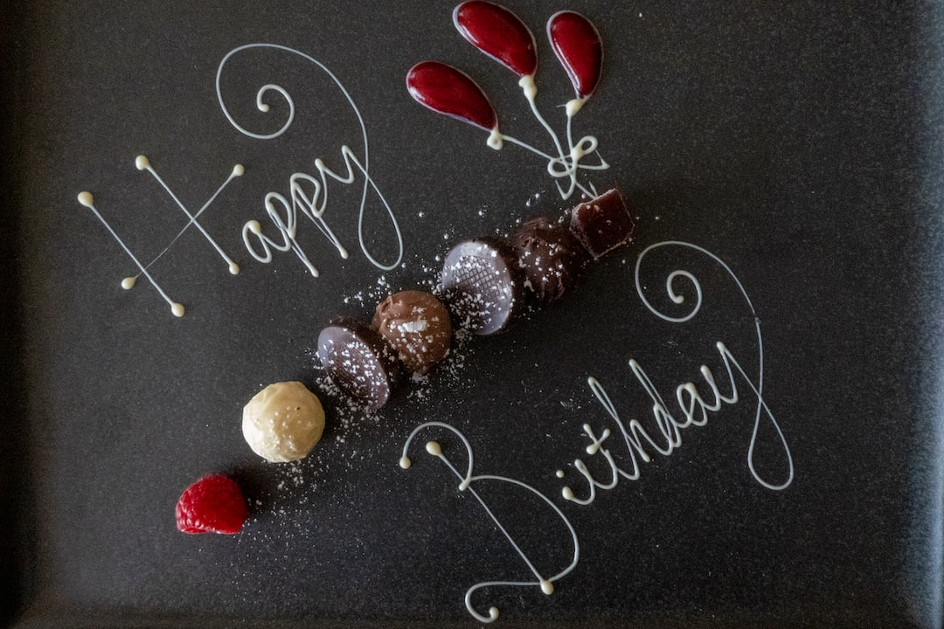
They want to feel appreciated.
Simple gestures go a long way!
Phone calls to say hello and thank you
Social media shout-outs
Invite them back to campus
Send holiday or birthday cards

Slide 13
What do alumni want?
Good news: Alumni want to hear from their departments!
Designed e-mails sent on behalf of departments have far better engagement than mailers sent from the College in general.

Slide 14
Mailers in 2023: A comparison
The College Connection:
Open rate = 41.56%
Click-through rate = 1.77%
Department newsletters:
Open rate = 49.10%
Click-through rate = 14.70%

Slide 15
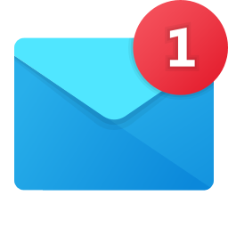
What do alumni want?
Alumni want consistent communications …
… And not necessarily lengthy communications.

Slide 16
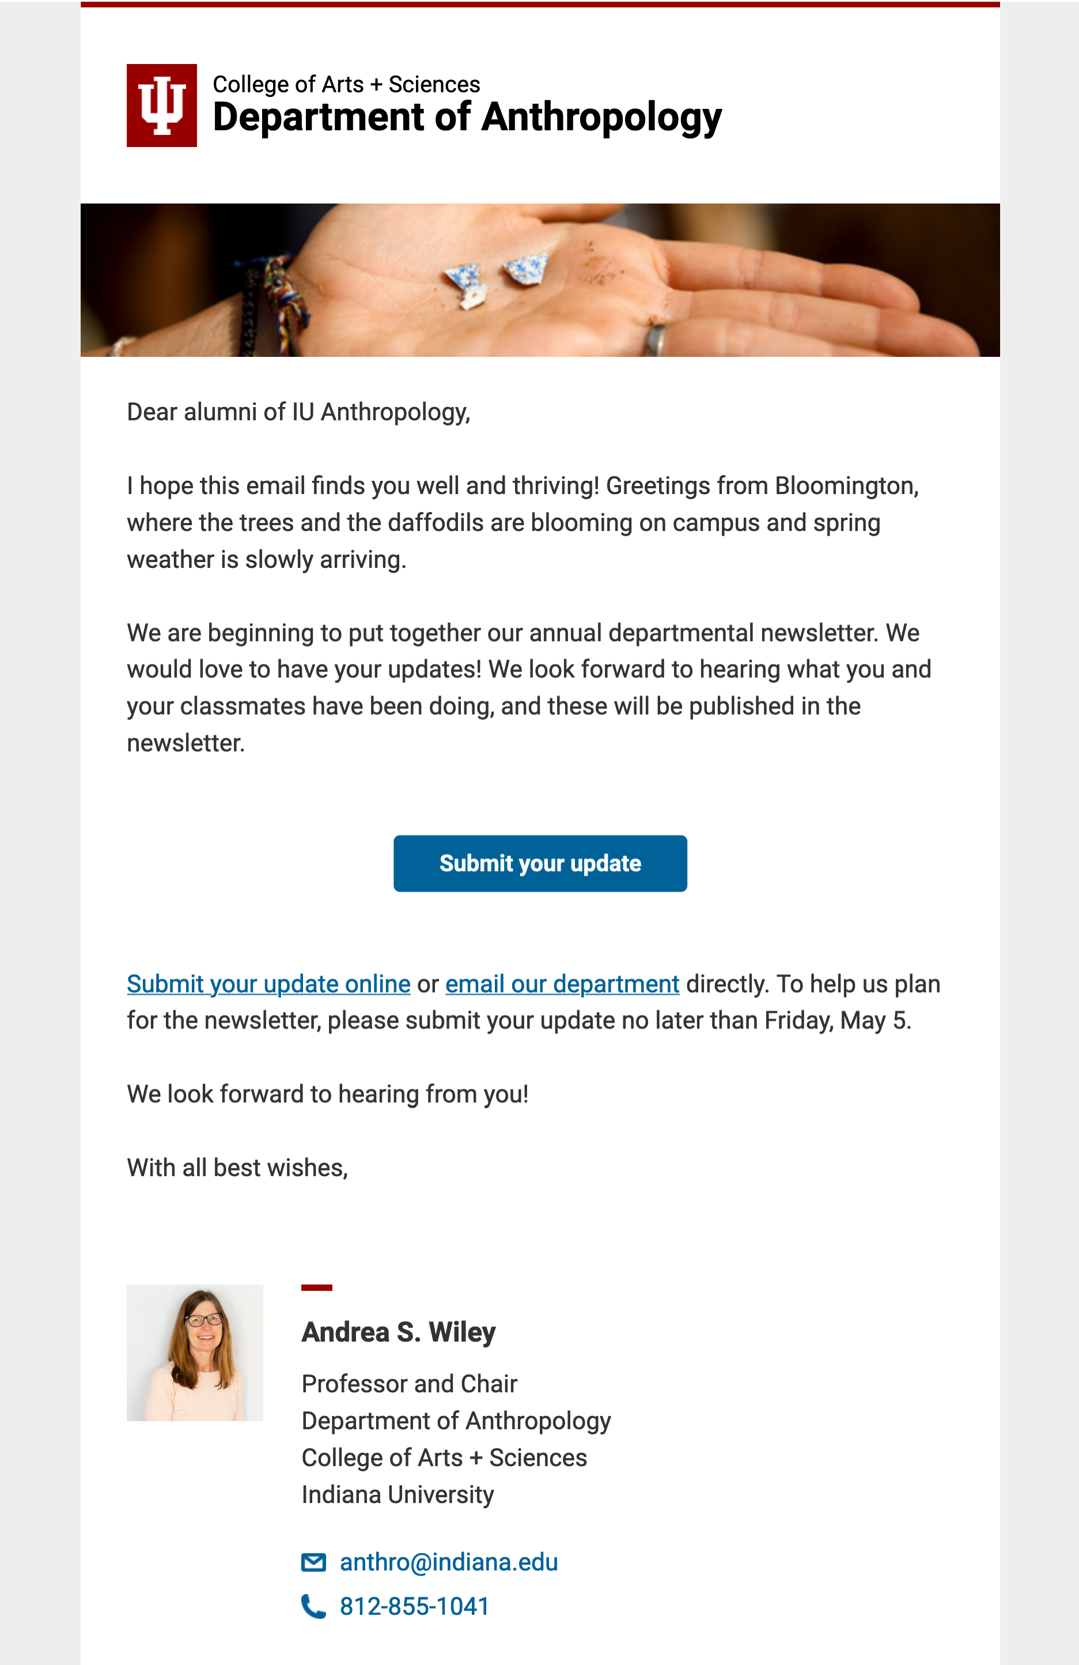
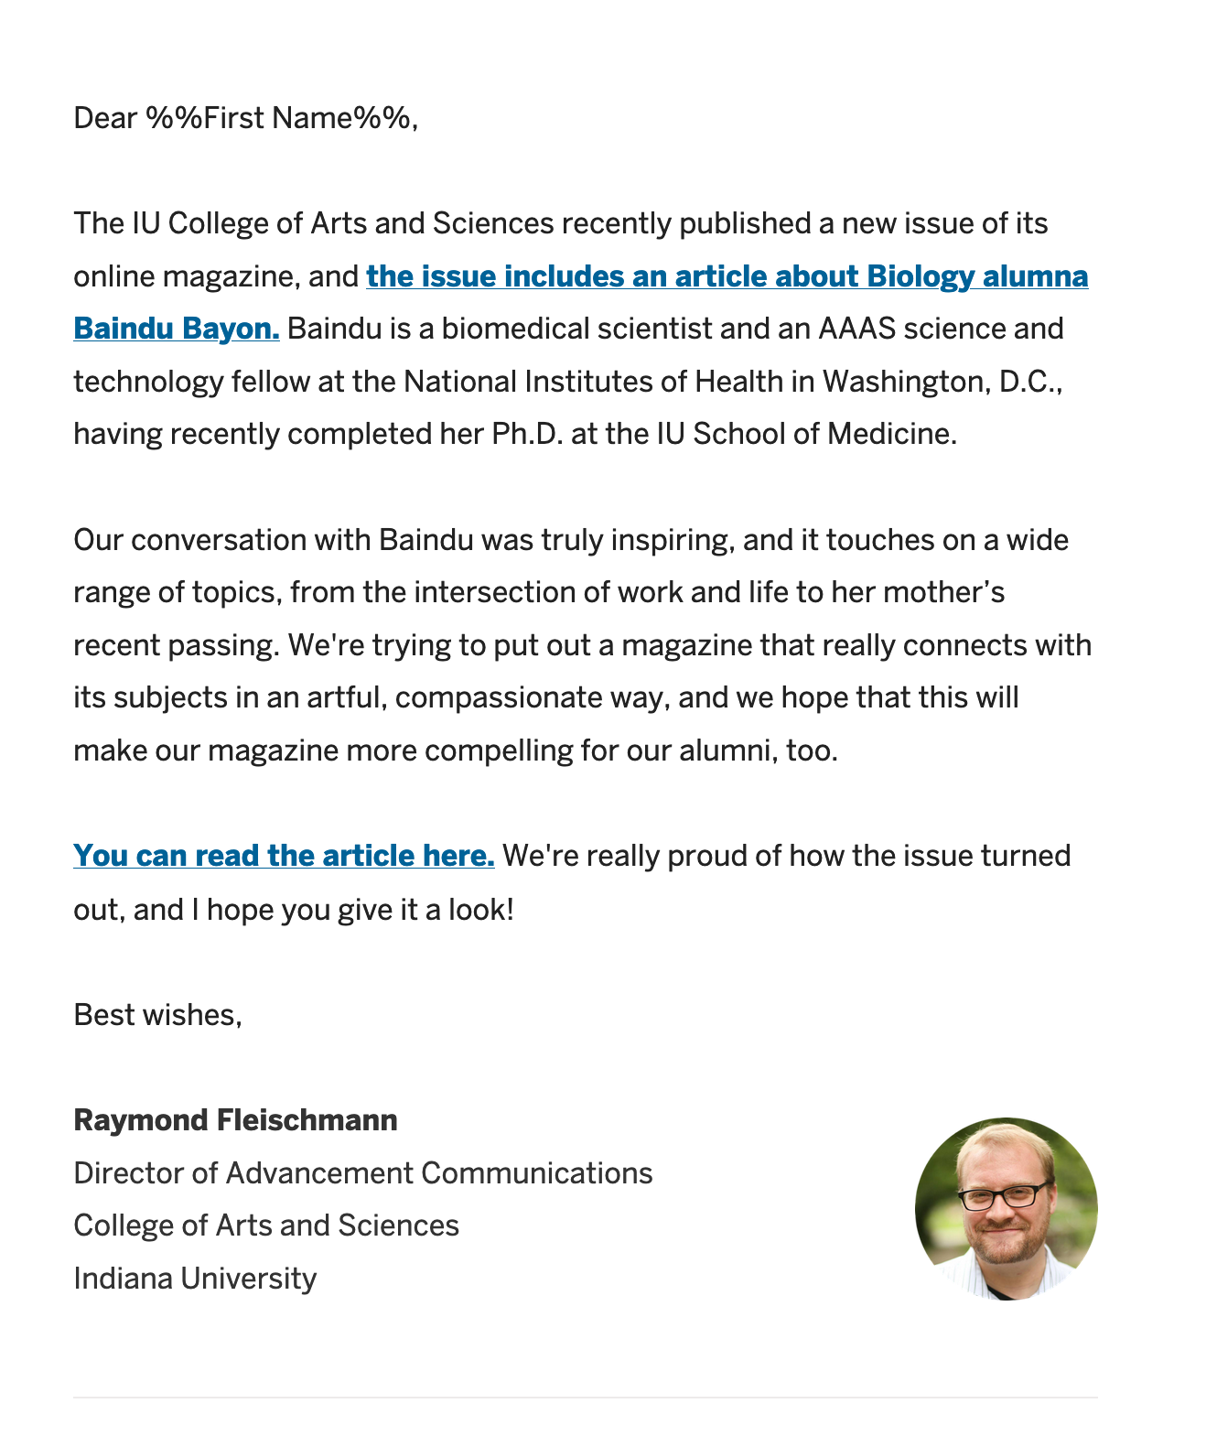

Slide 17
What type of content is most engaging?
Alumni want to hear about current students, other alumni, and faculty research — typically in that order of interest.

Slide 18
How is our office communicating with alumni?
(including your own)
Well, lots of ways.
We send … a lot of e-mails.
1,529,213 e-mails sent last year via 120 distinct sends.

Slide 19
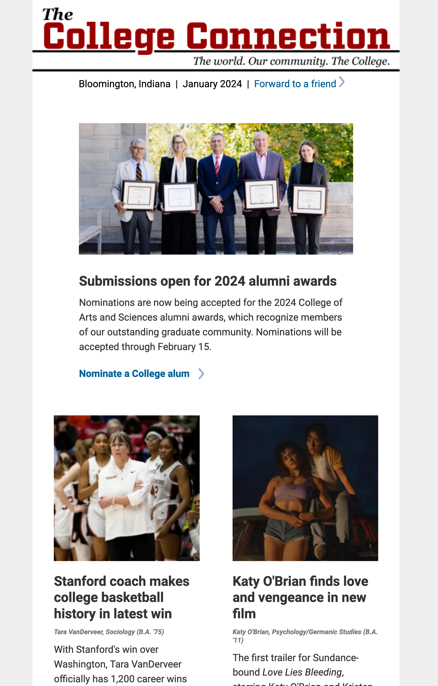
The College Connection
Mailed monthly

Slide 20
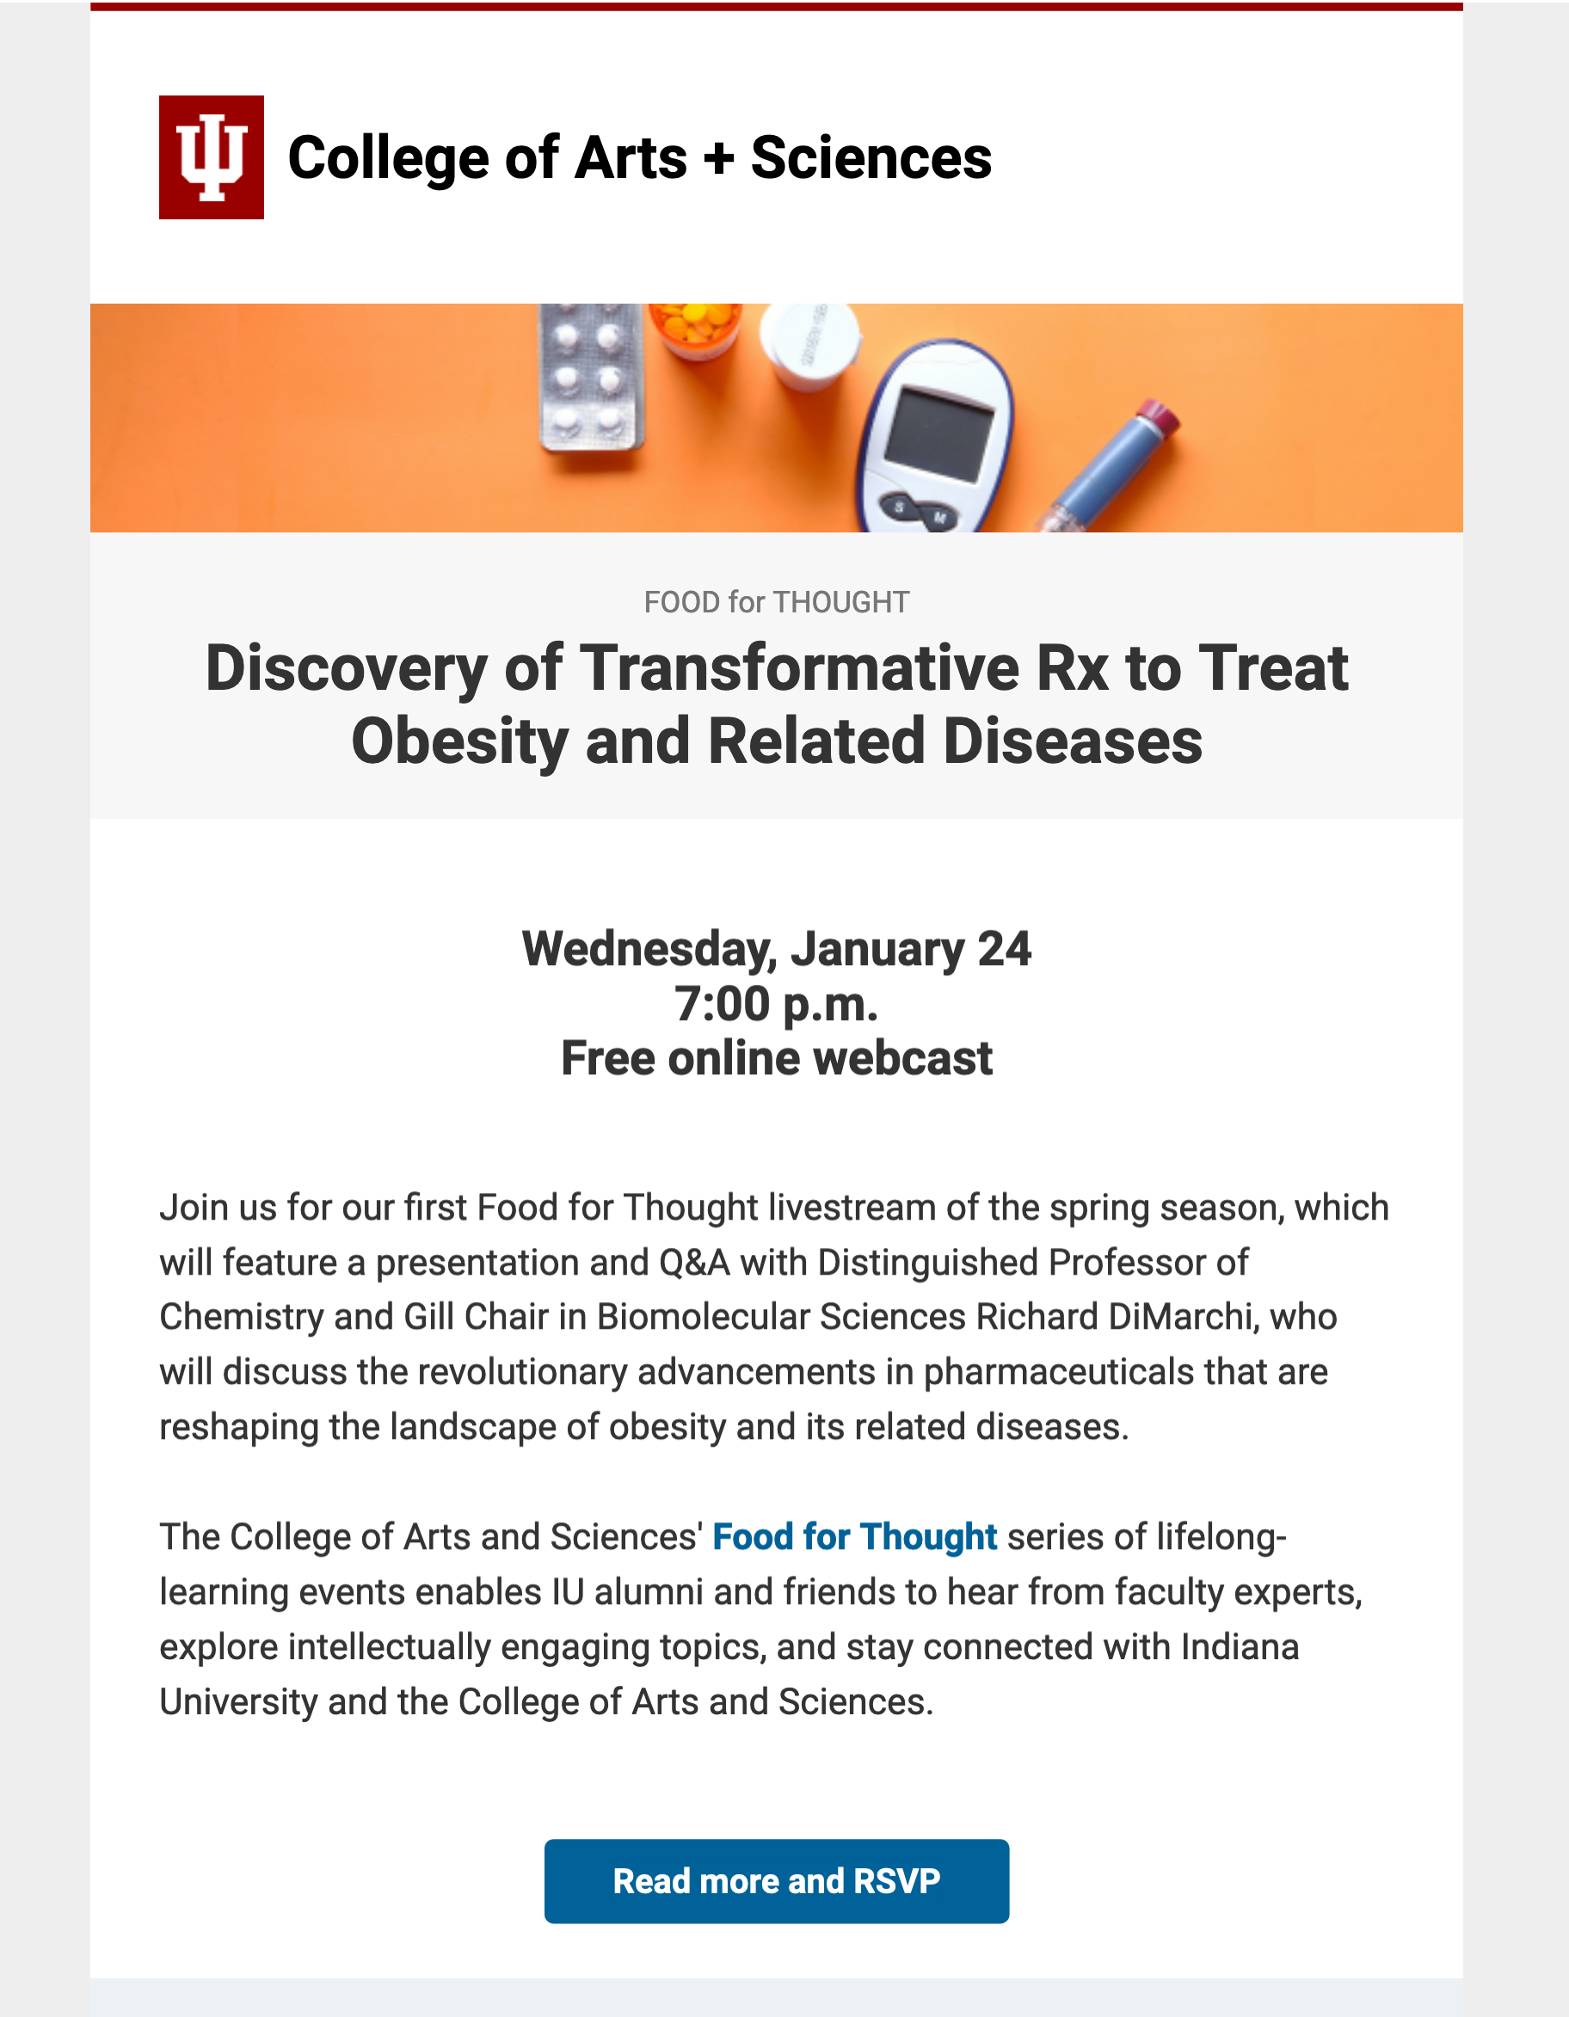
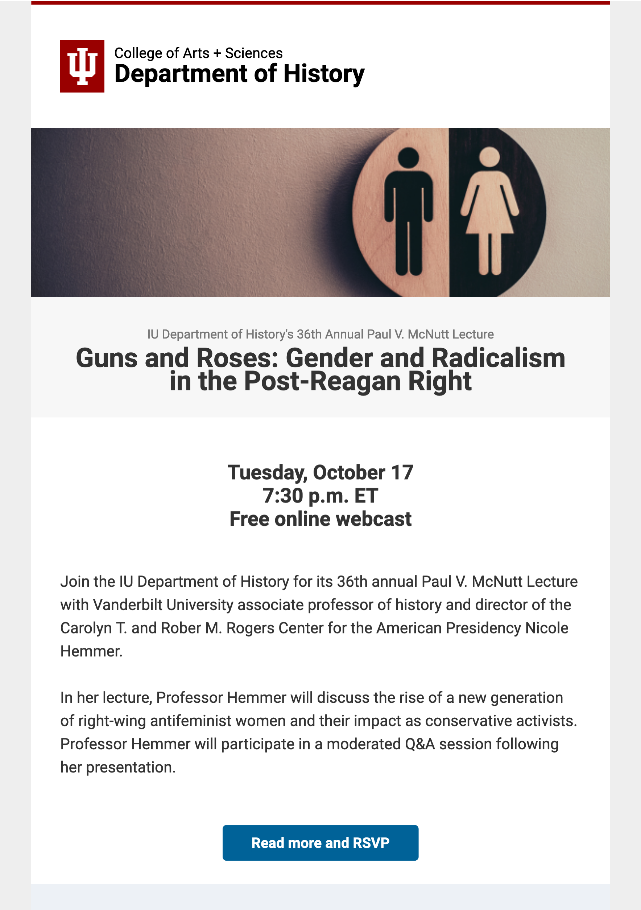
Event mailers, both internal and departmental
Mailed on a rolling basis

Slide 21
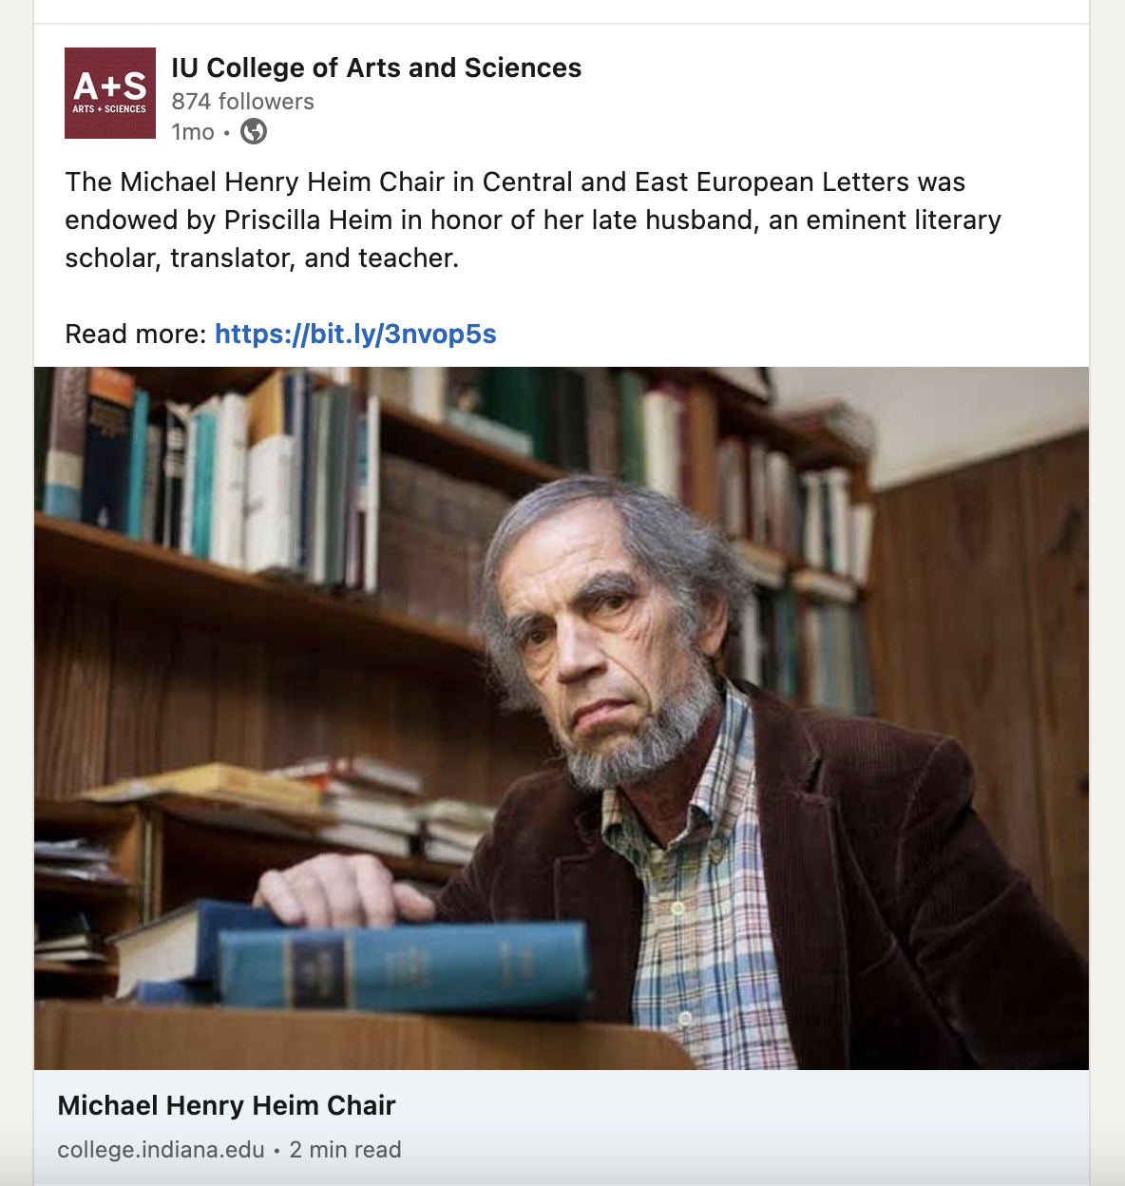
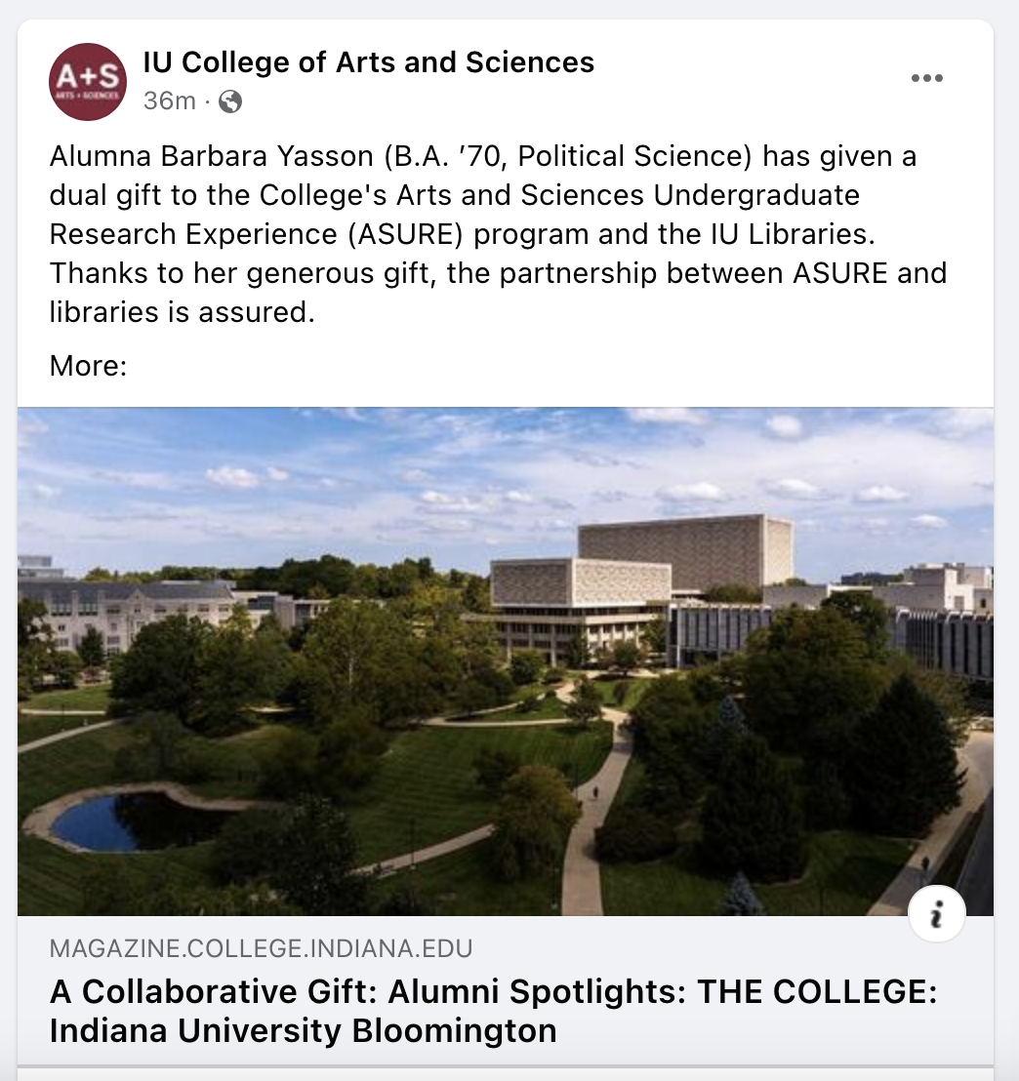
Social media
Posts coordinated with the College's Office of Communications and Marketing

Slide 22
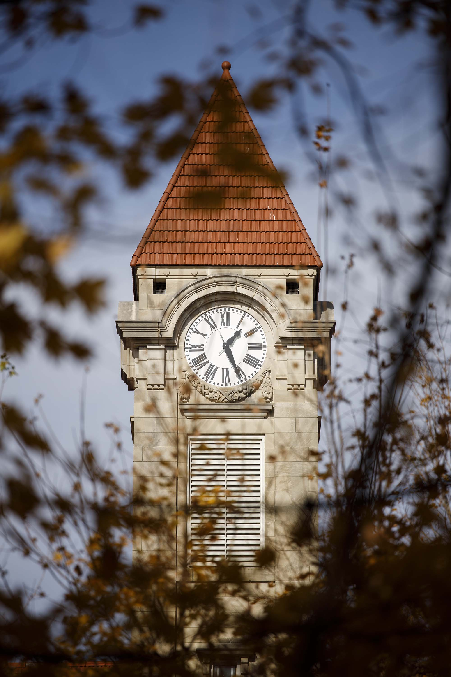
Coming soon!
Quarterly impact updates, delivered as designed e-mails
Audience: All donors, both
active and lapsed
Content: Select student spotlights, faculty spotlights, quotes from scholarship recipients, select donor statistics

Slide 23
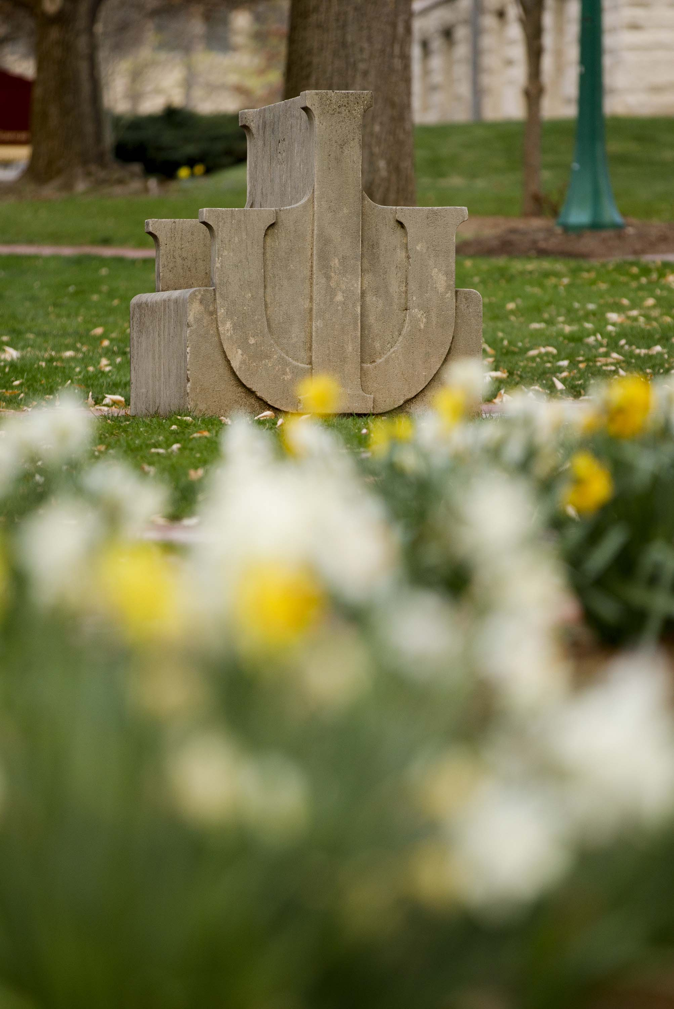
Also coming soon!
Quarterly advancement updates, delivered as designed e-mails
Audience: You!
Content: Articles recently published online, links to recent departmental newsletters, highlights of departmental events, other helpful info for alumni and advancement work

Slide 24
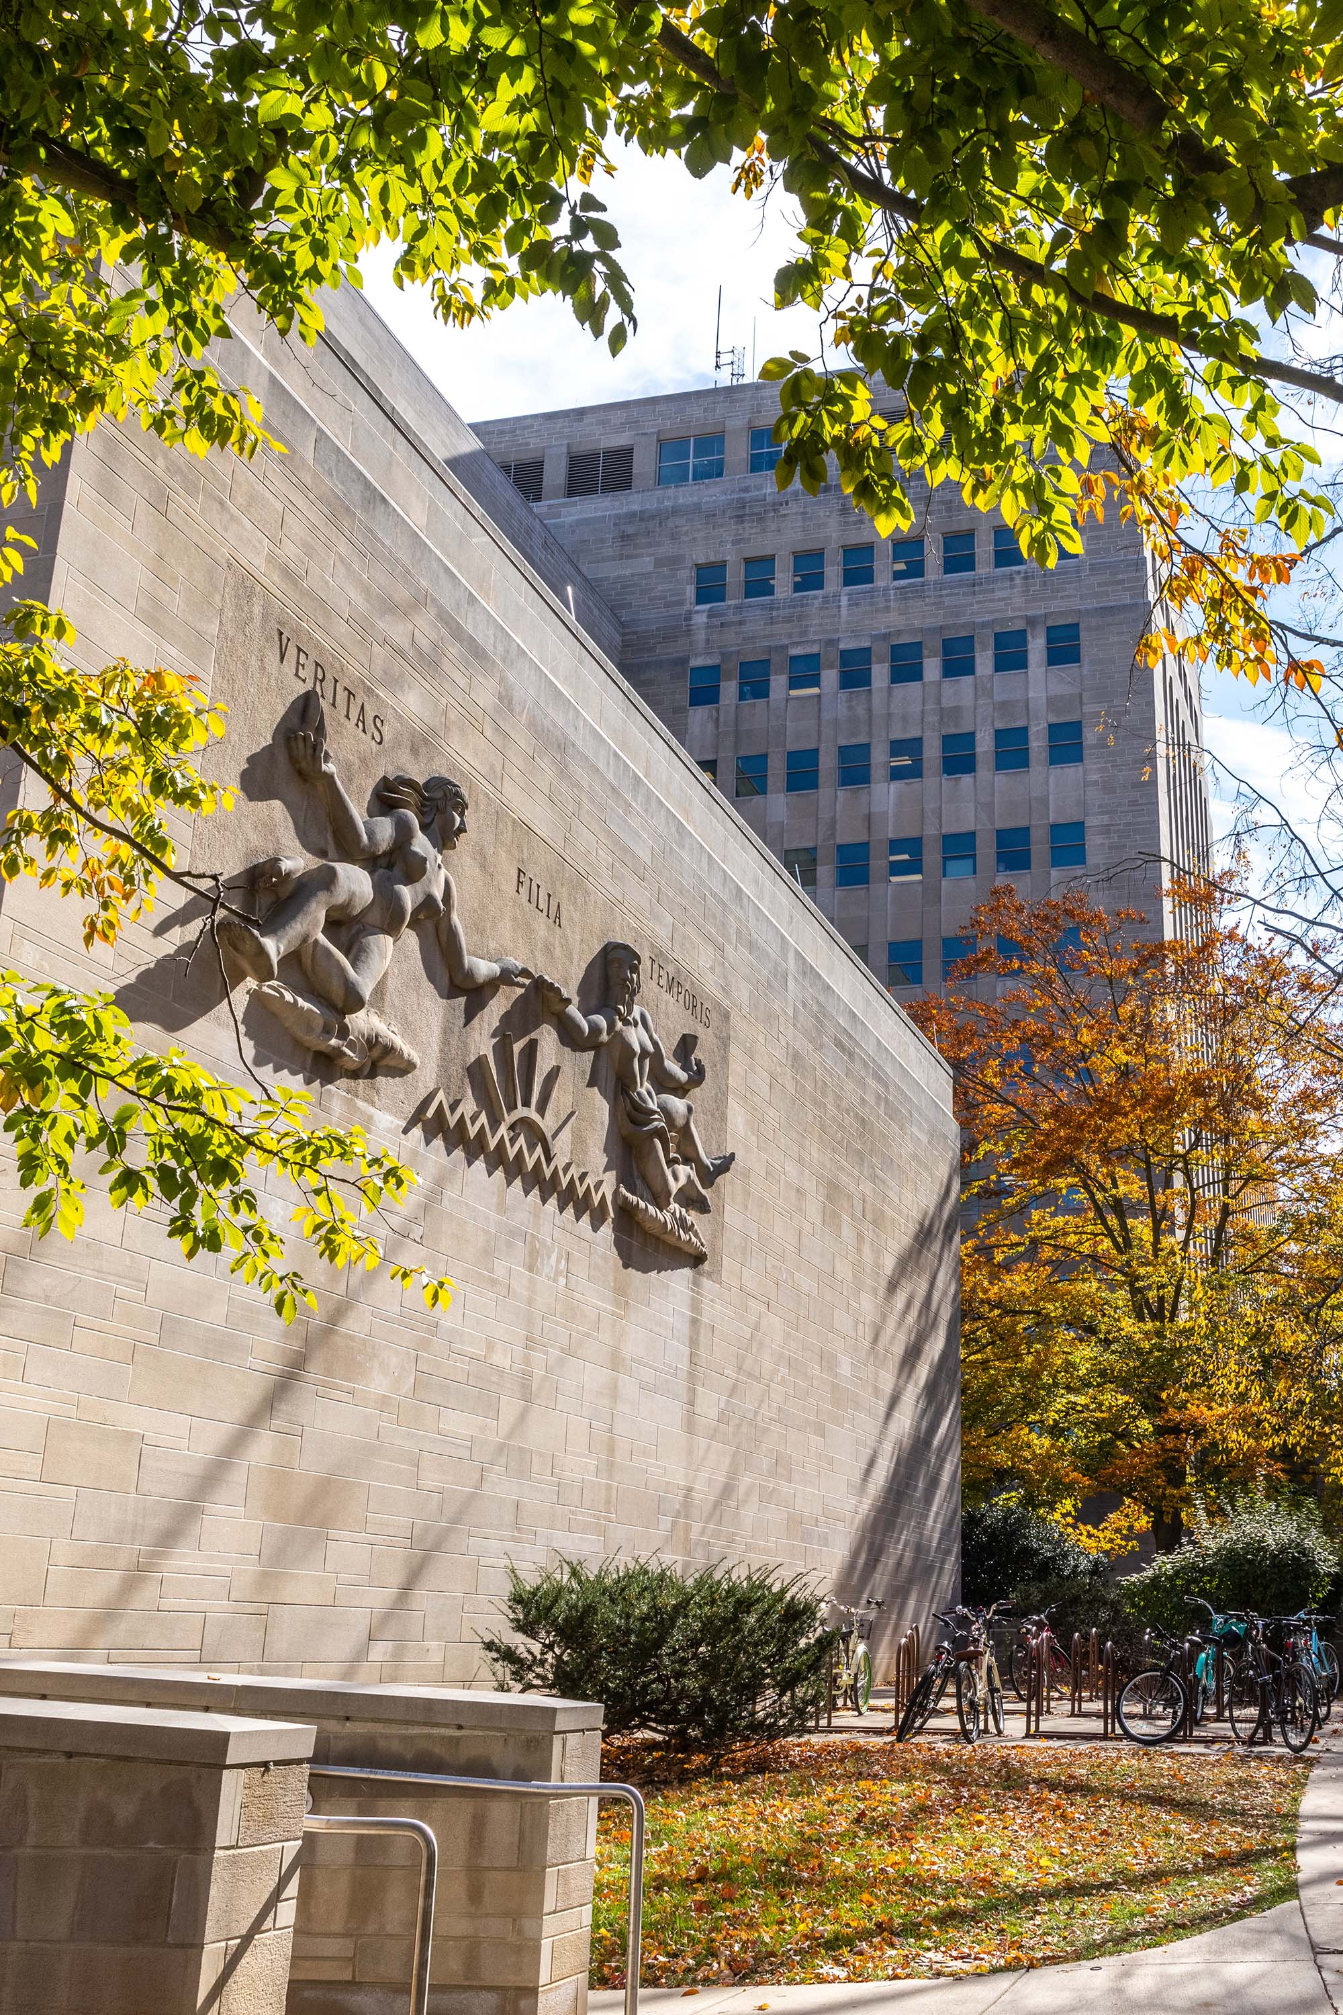
Collaborating with our office
With our office's assistance, how can you communicate with your alumni?

Slide 25
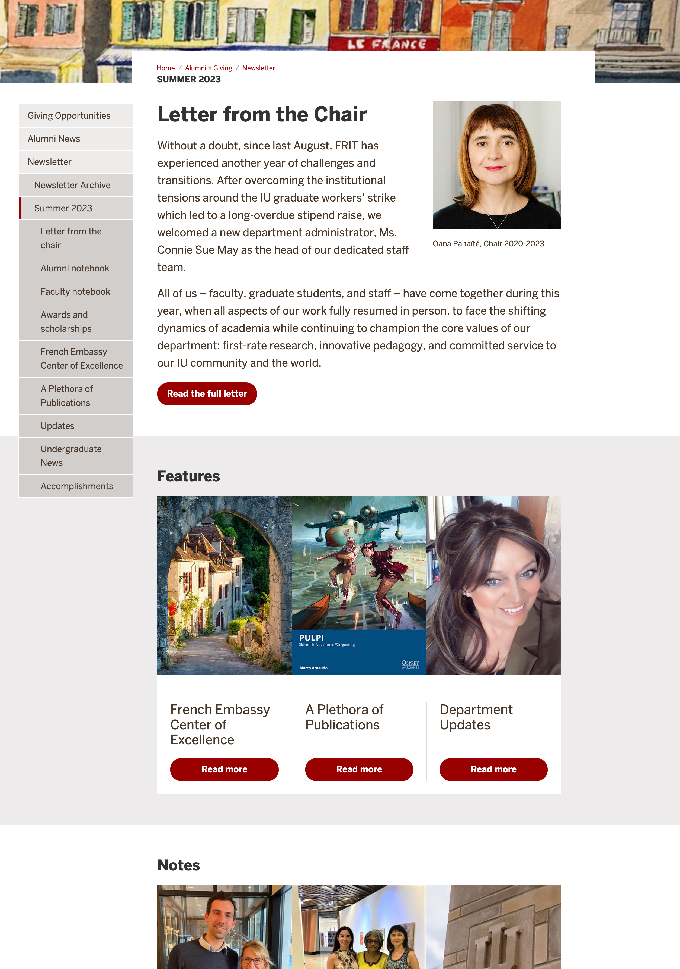
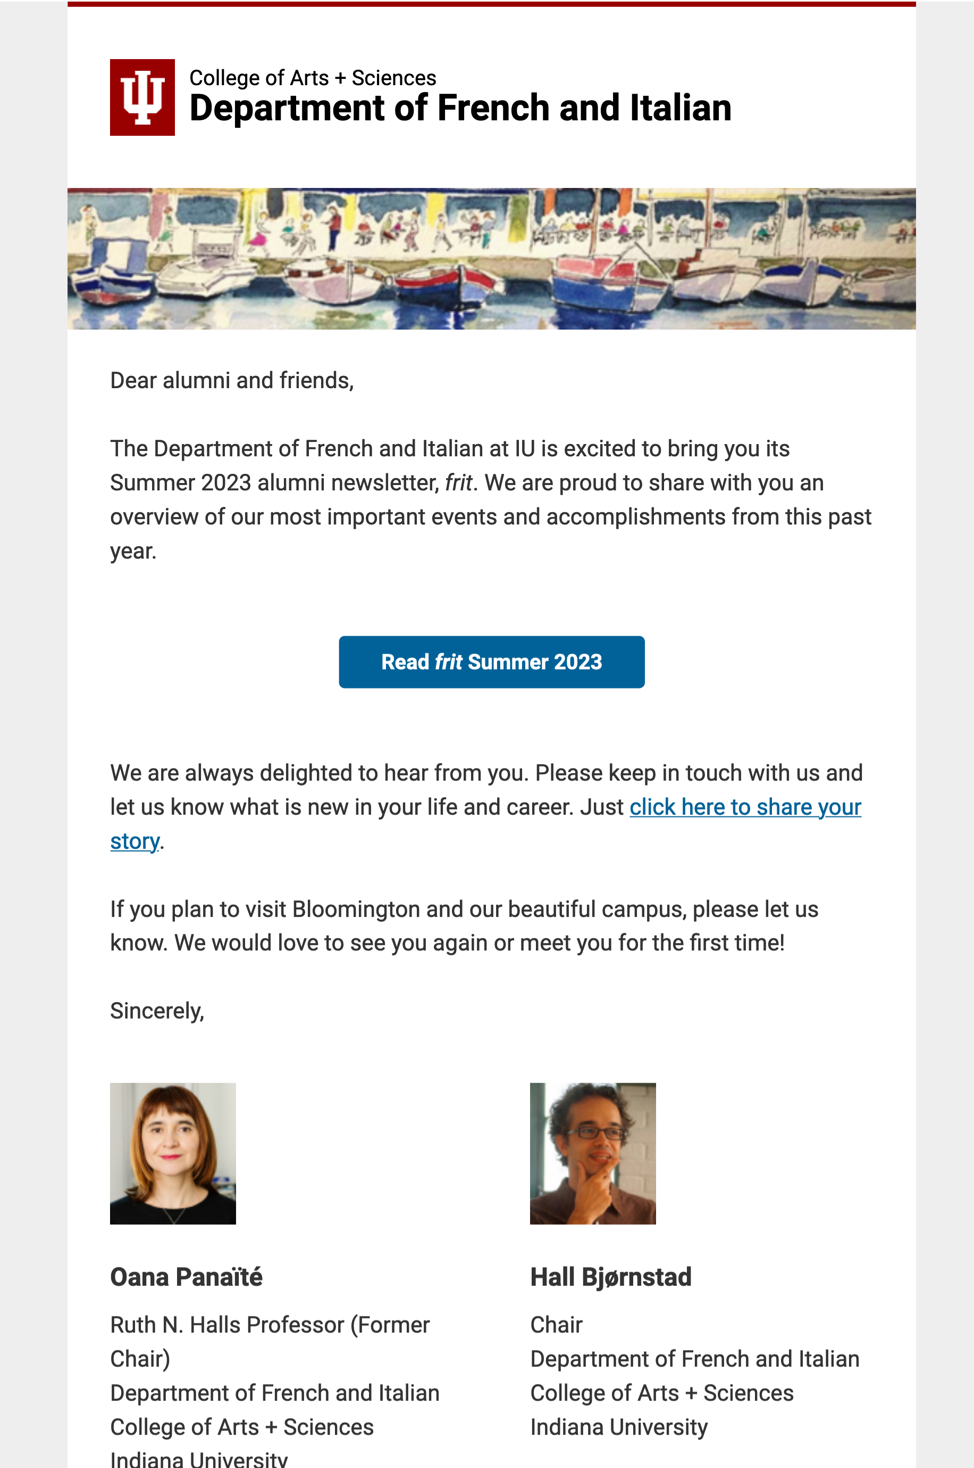
Newsletter design and promotion
Most frequently, we collaborate with departments on their newsletters.
The departments create all the content, and then we design it online and mail it out to their alumni.

Slide 26
Recent examples
French and Italian: go.iu.edu/4RTi
Center for Biodiversity: go.iu.edu/4RTj
Germanic Studies: go.iu.edu/4RTk
Comparative Literature: go.iu.edu/4RTl
If you'd like to know more, e-mail me at rfleisch@indiana.edu.

Slide 27
However …
Newsletters often take a long time, right?
And thus many departments can only make them once a year or so, right?
And one of our goals is consistent alumni communication … not necessarily a single, annual huge communication, right?

Slide 28
Thinking differently
What if you communicated in smaller, more frequent ways?
For instance, put together a nice (even brief) article about a student, alum, or faculty member, embed it on your news page, and we'll send it to your alumni via a mailer from you. No lengthy newsletter is necessary.

Slide 29
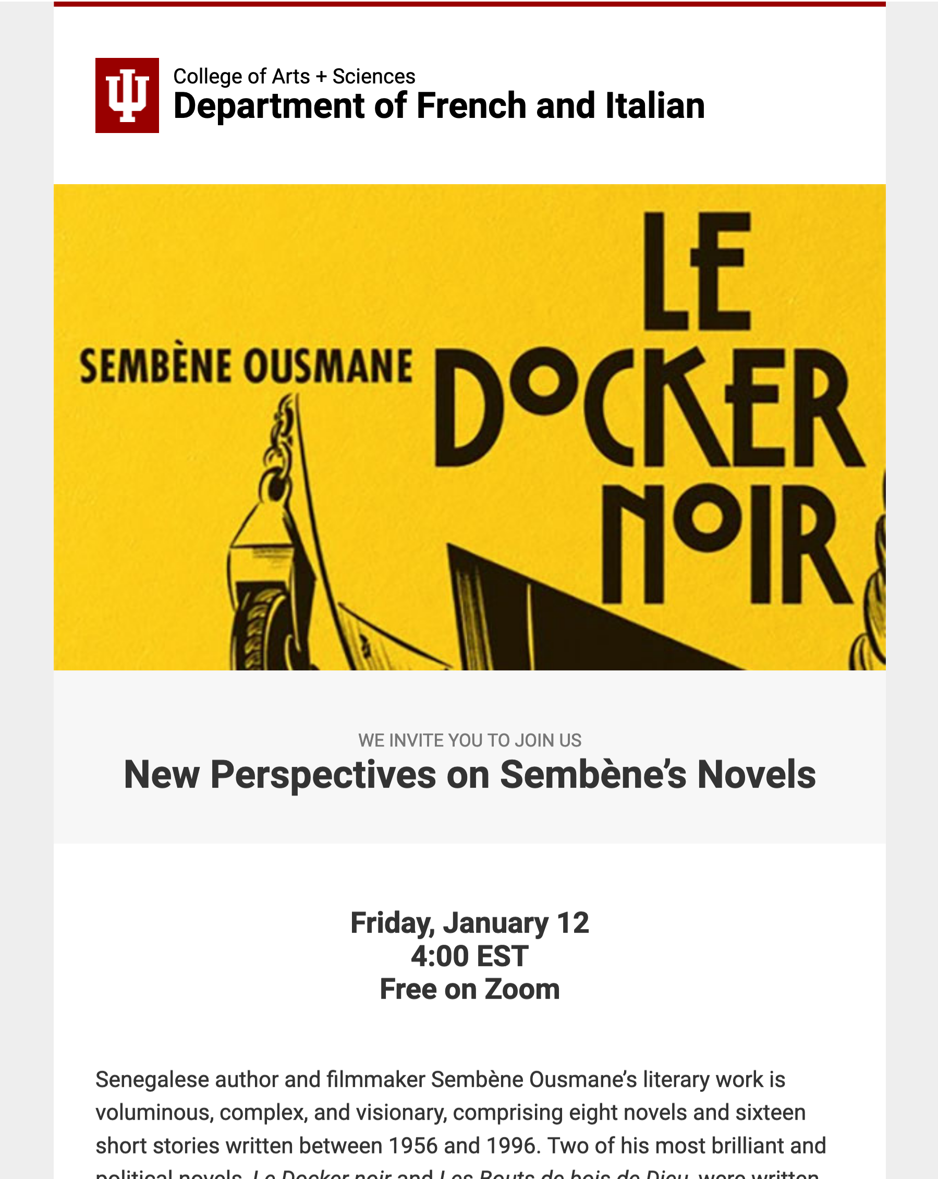
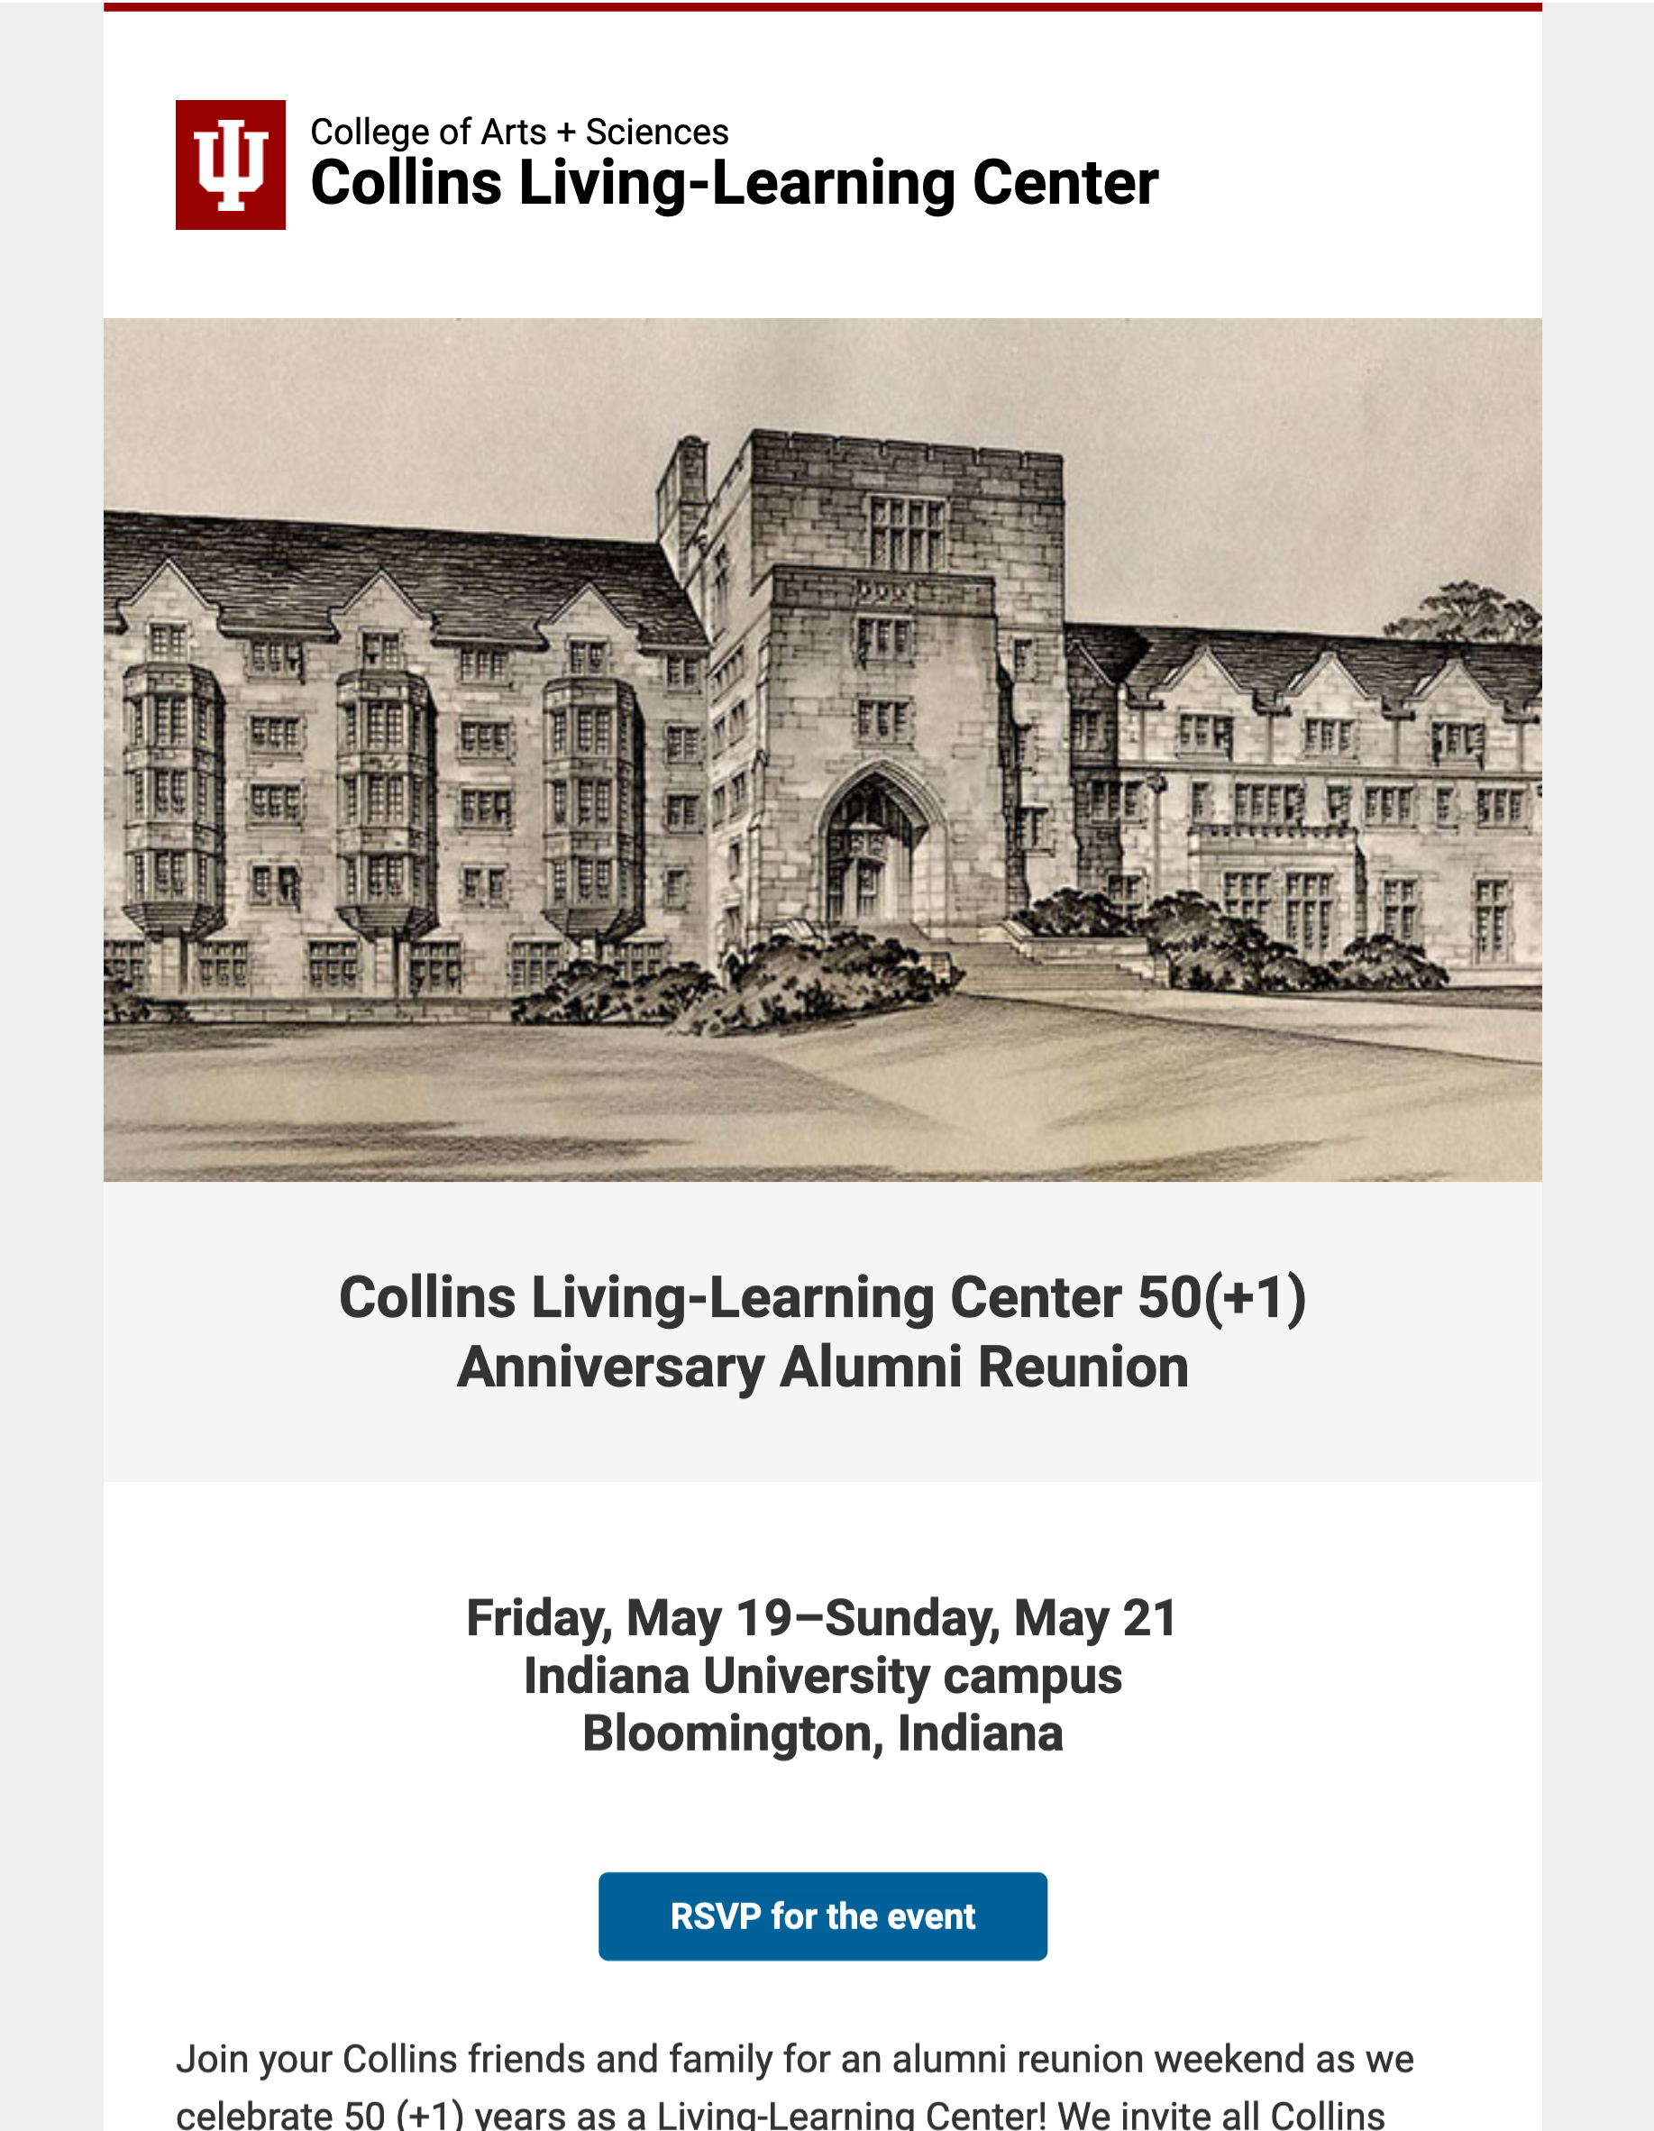
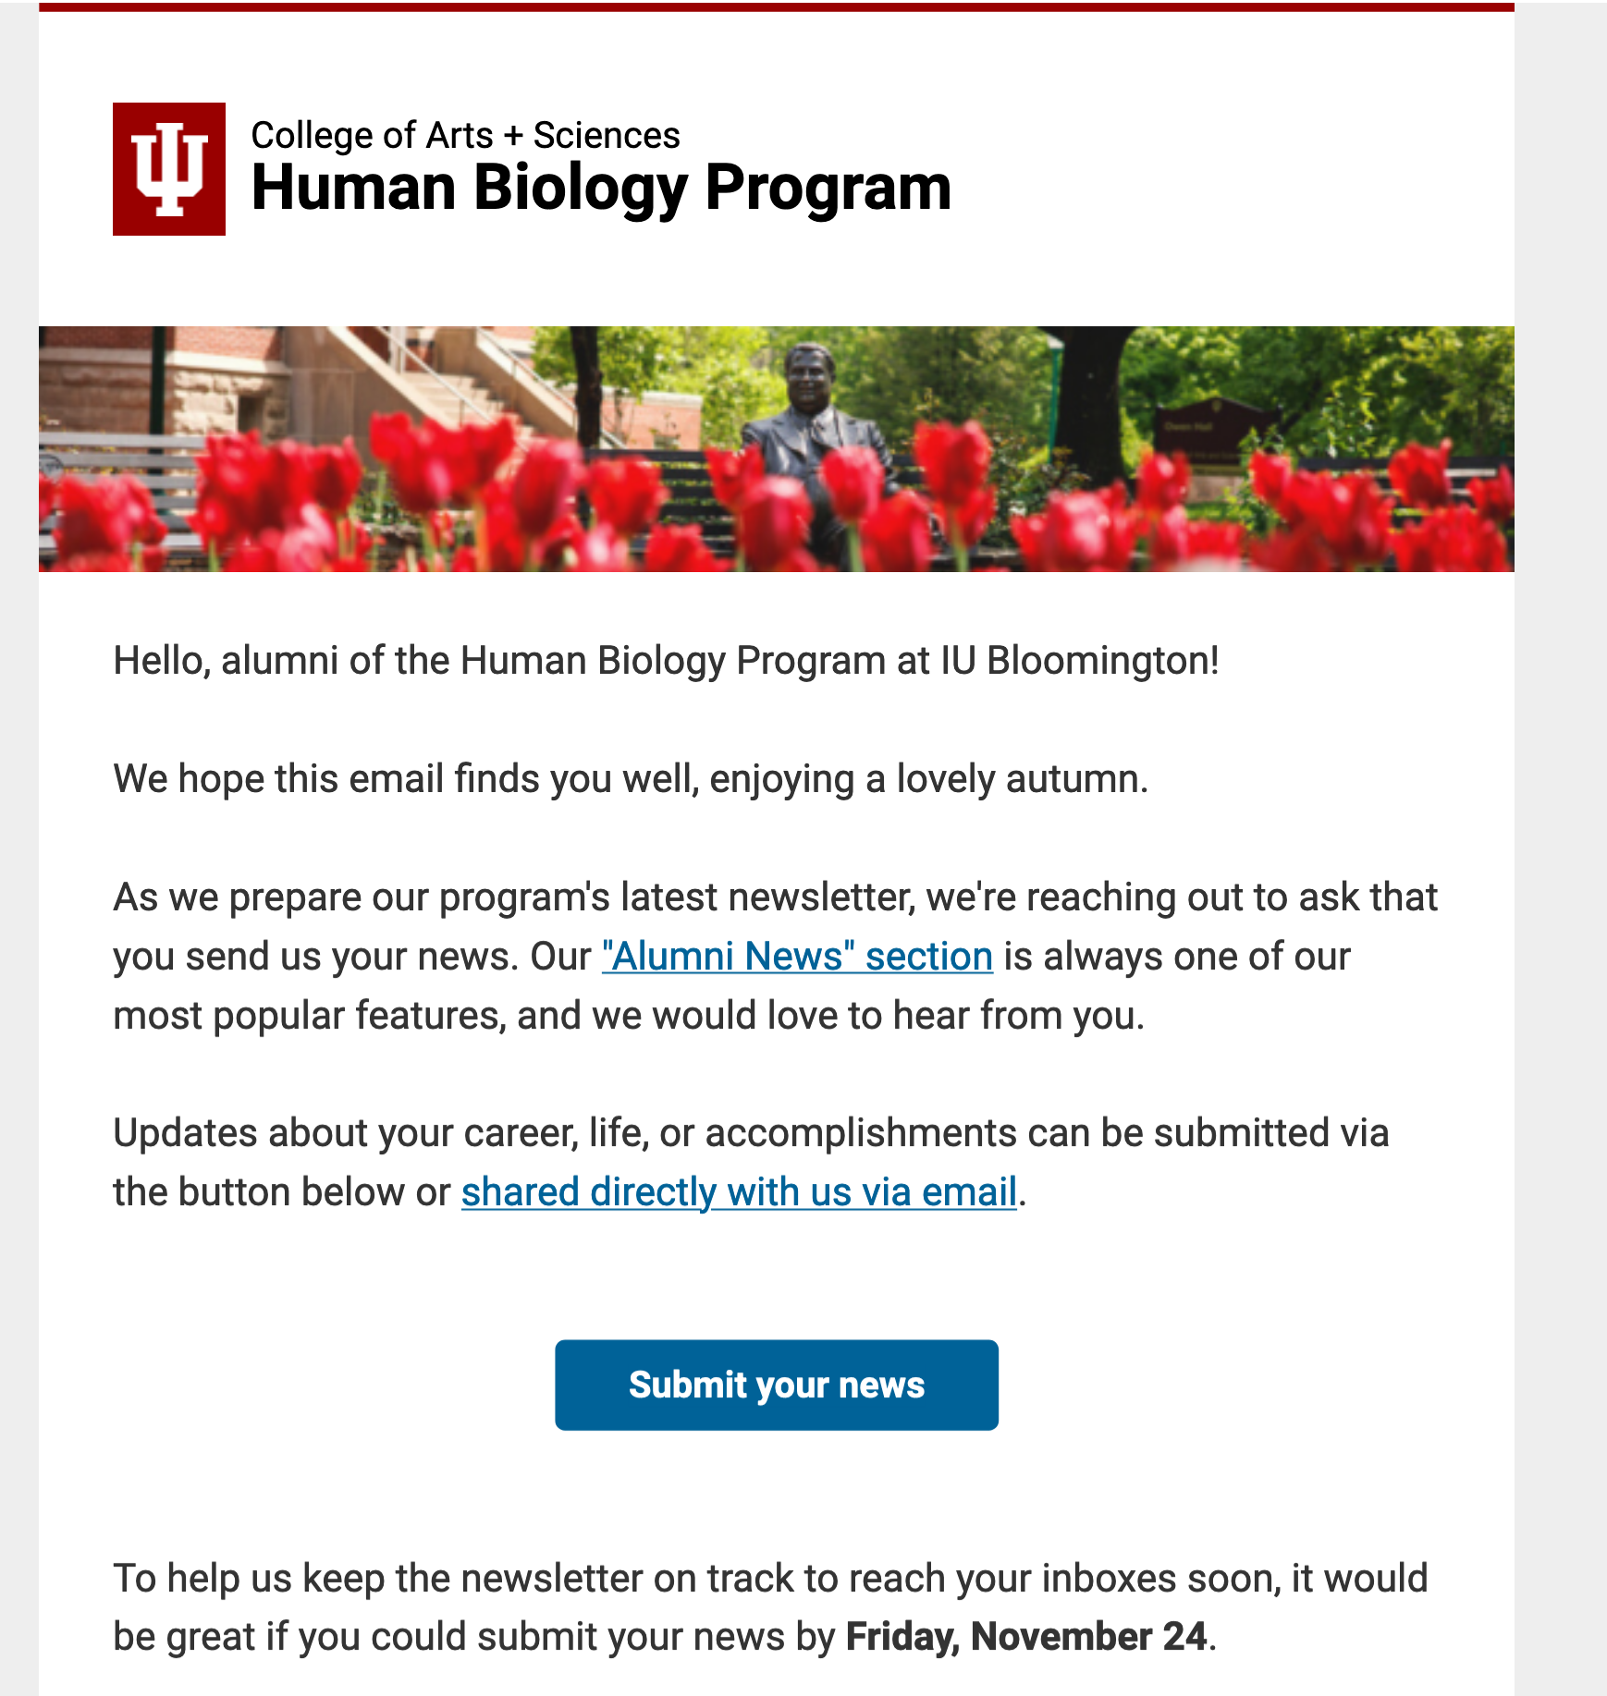
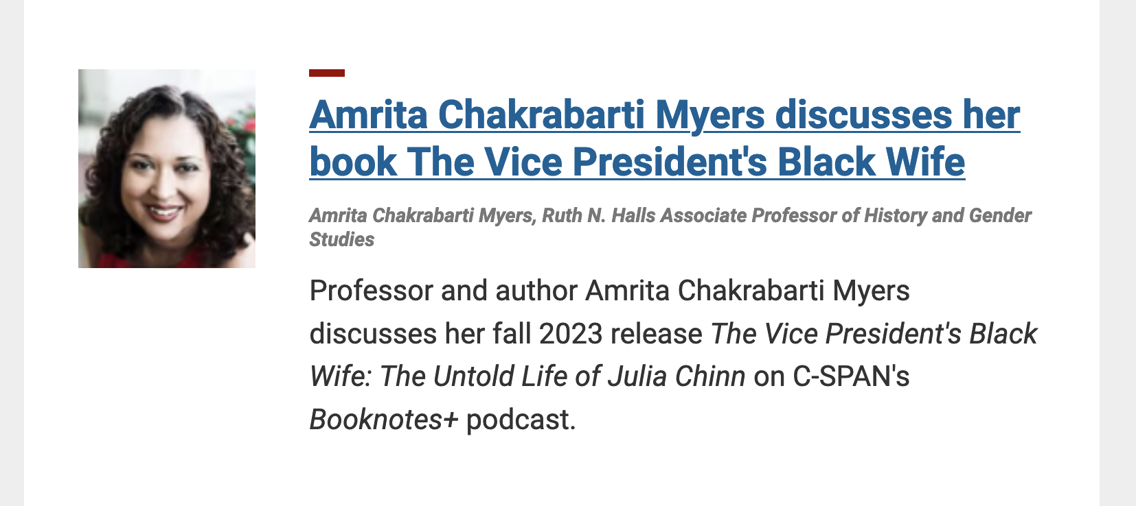
Other support from our office
Event promotion
Major celebrations and anniversaries
Calls for alumni news
Promotion via our own mailings, such as The College Connection

Slide 30
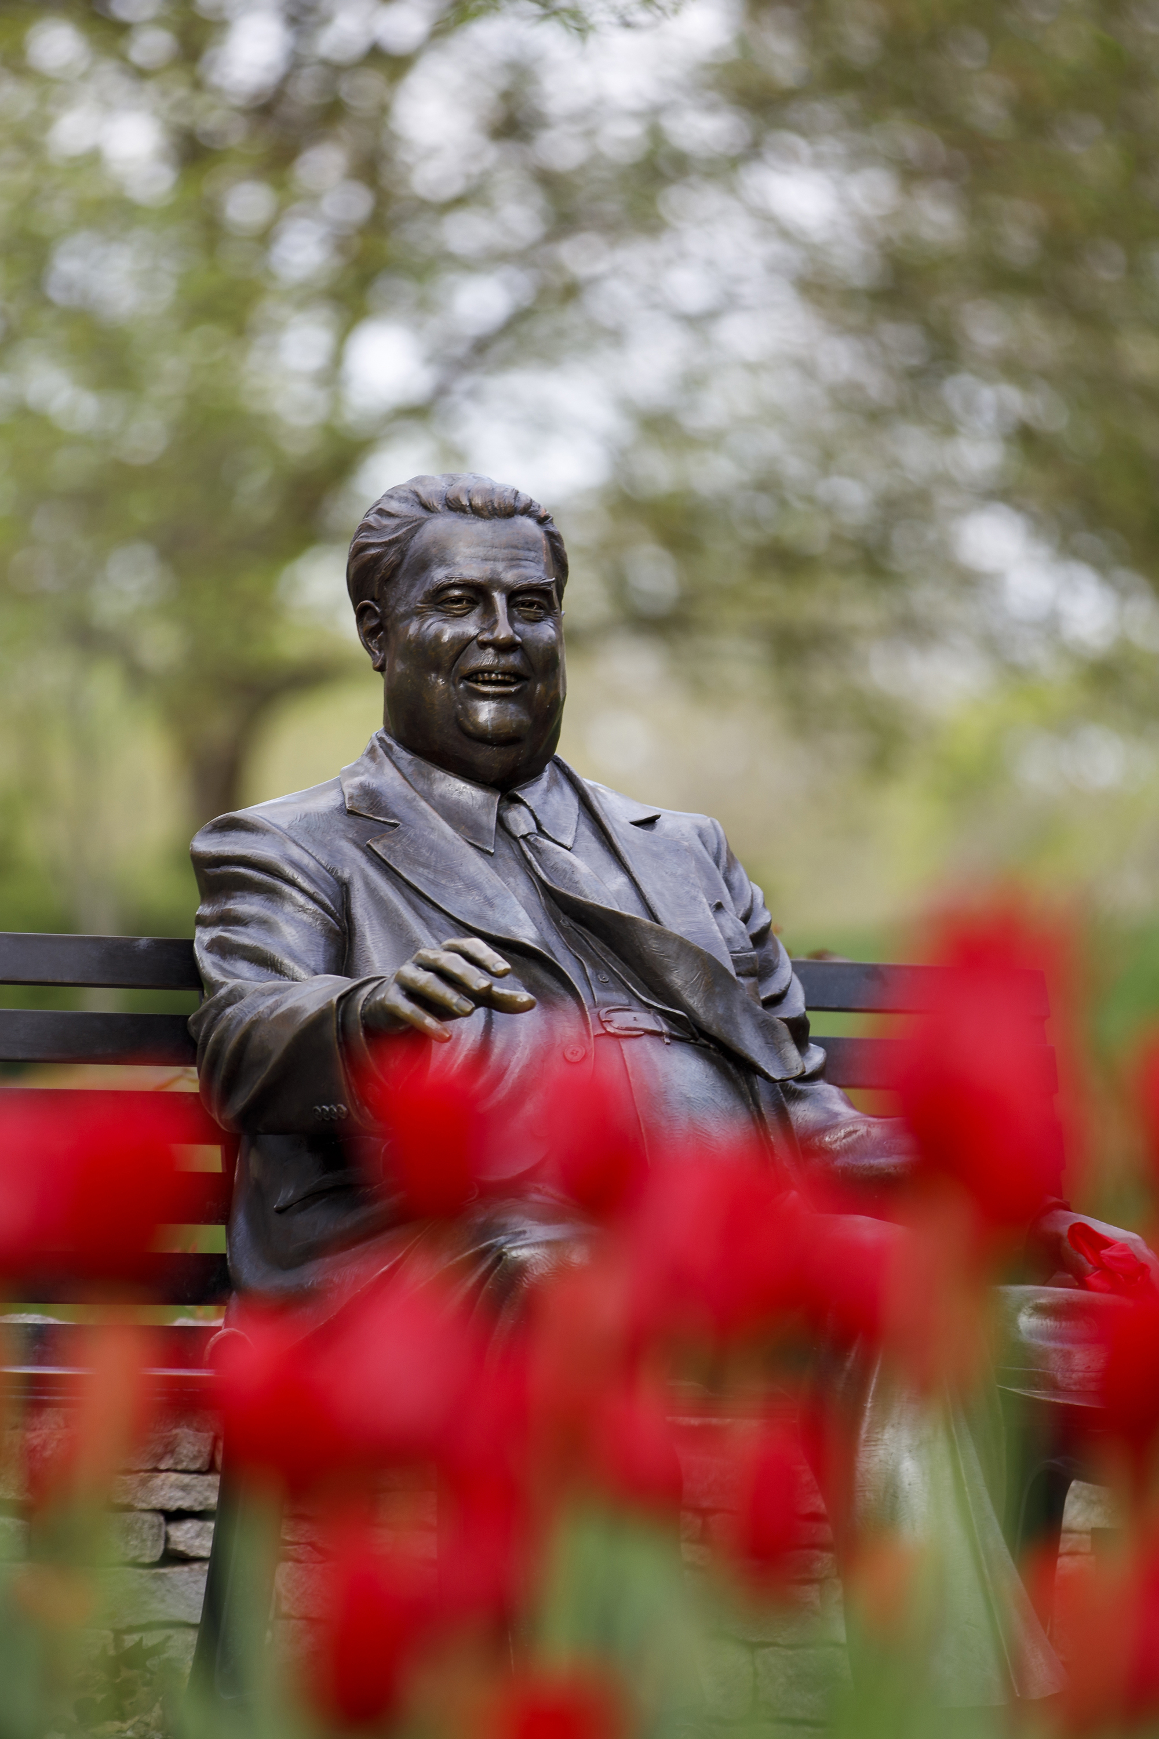
So, stay in touch!
Send us your news …
Ideas for collaboration …
Upcoming events you'd like help promoting …
And assorted alumni communications.

Slide 31
What questions do you have?

Slide 32
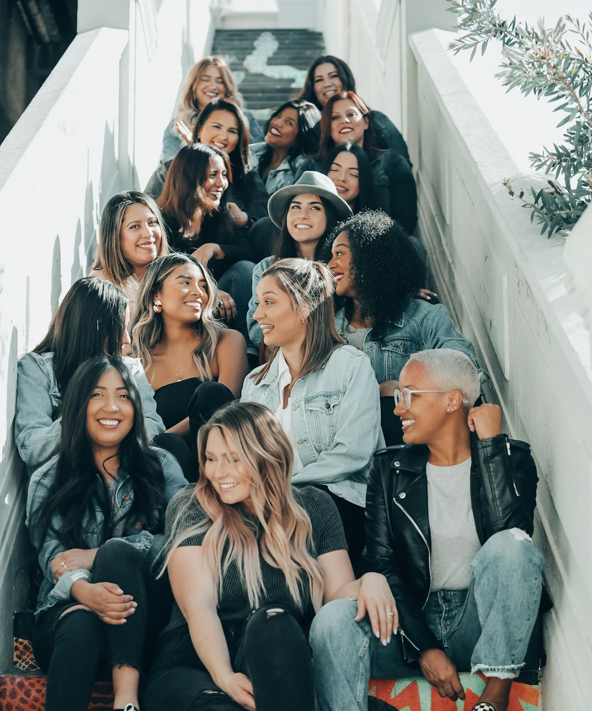
Thank you for attending the Deep Dive workshop.
Save the Date: Friday, March 22, 2024
The next Deep Dive topics will include:
Gift Acknowledgment Best Practices
Endowment Donor Stewardship Best Practices
Alumni/Donor Data Maintenance

