Slide 1
Donor Recognition and Endowment Stewardship
Advancement Deep Dive Session for Academic Departments, Programs, and Schools

Slide 2
Setting the Stage
Role of the College and the IU Foundation in acknowledging gifts
Gold standard practices in donor stewardship
Scholarships and Fellowships
But first … a bit about College alumni and our drive to enhance contact information

Slide 3
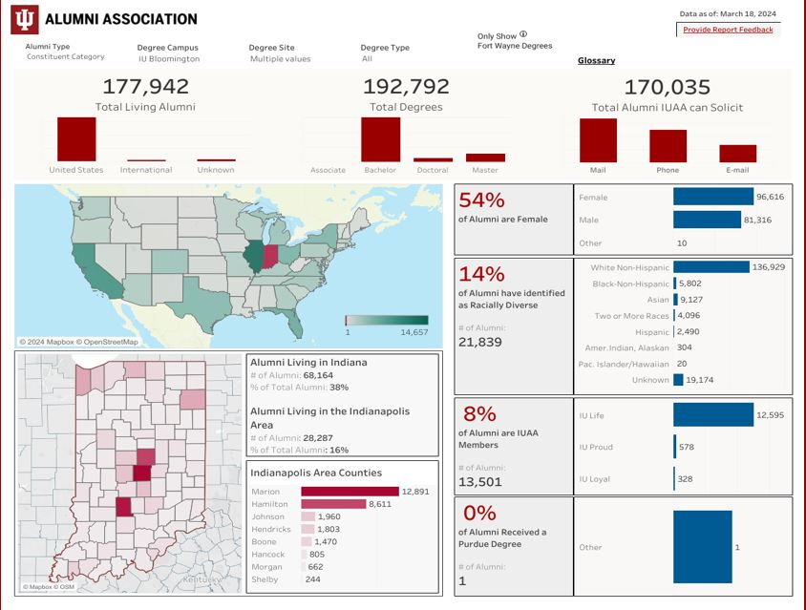
College Alumni Snapshot
168,582 Mail
123,357 Phone
79,797 Email

Slide 4
We need your help!
Alumni tend to have the greatest affinity to their academic unit (You!)
Request updated contact info when you communicate with them
Add a "share your story" feature to your website
Involve faculty members when reviewing alumni lists
Consider a link in your signature line to encourage updates
College of Arts and Sciences' Alumni Update Form
https://college.indiana.edu/landing-pages/surveys/update-information.html
IU Alumni Association: https://www.myiu.org/

Slide 5
DONOR ACKNOWLEDGMENT
Expressing gratitude and showing appreciation to donors

Slide 6
The Donor Acknowledgment Process: An Inside Look
IU Foundation
Ensures prompt acknowledgment, validating contributions and providing necessary receipt documentation.
2. The College
Personalized acknowledgments from the College's Executive Dean convey sincere appreciation for donors' support.
3. Departments/Programs
Direct acknowledgments from departments deepen the connection with donors and express gratitude for their designated support.

Slide 7
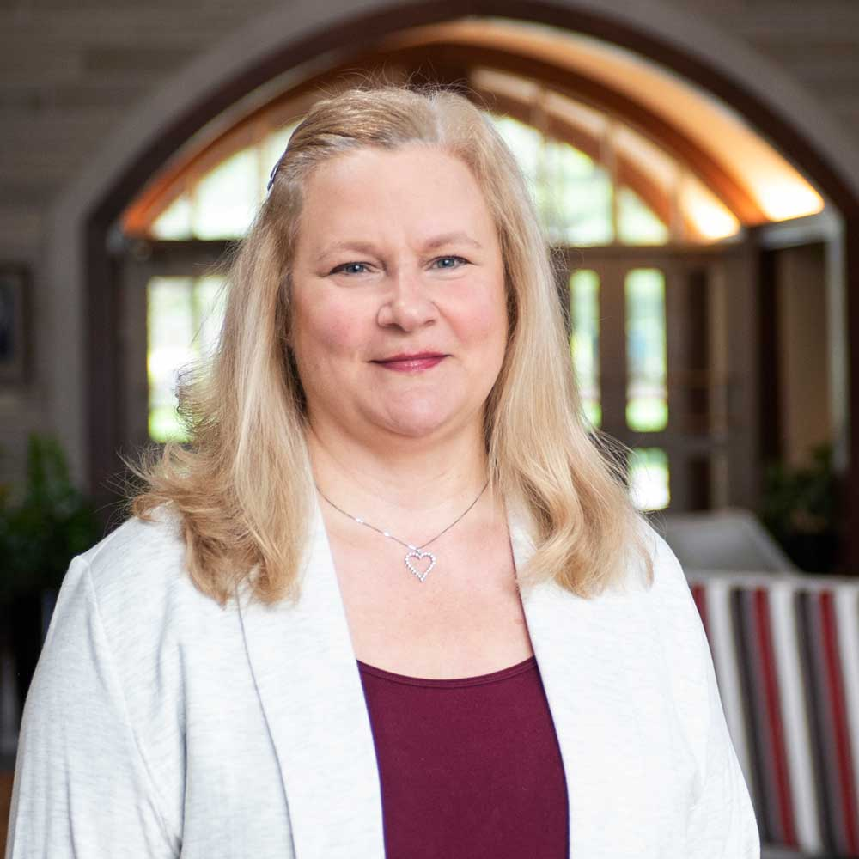
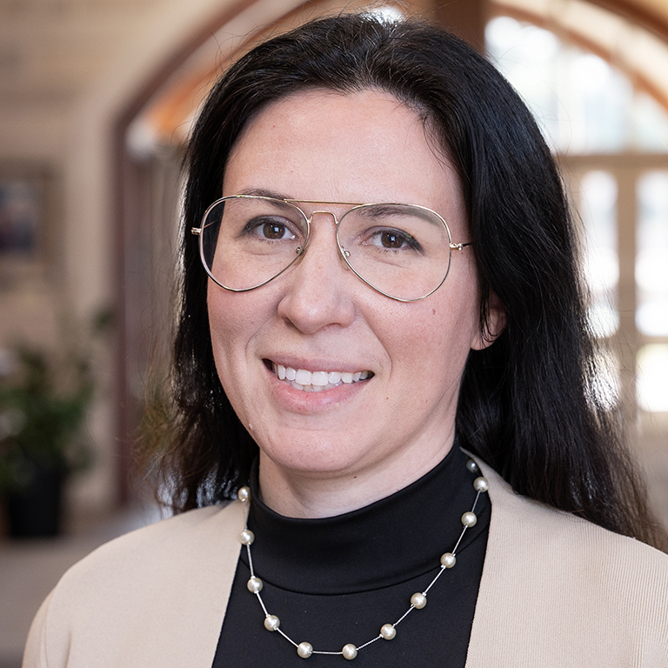
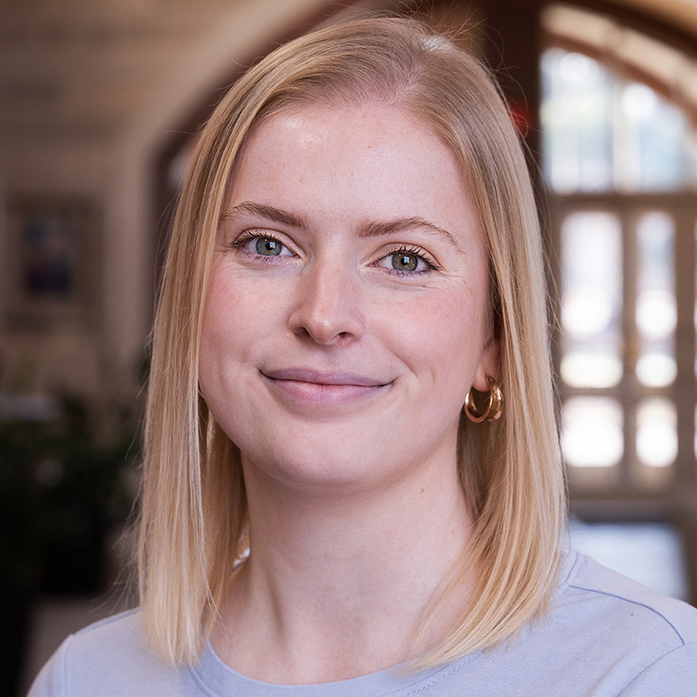
IU Foundation Donor Relations Team
Ann Bunjan
Manager, Acknowledgements
and Reporting
Hannah Hirsch
Manager, Stewardship Officers
Rachel Barrett
Stewardship Officer

Slide 8
IUF Donor Relations
Acknowledgement Process

Slide 9
What we do
The IU Foundation Donor Relations team strives to ensure that donors experience extraordinary, personalized, and meaningful interactions with Indiana University that reinforce the impact of their generosity and foster long-term engagement and investment.

Slide 10
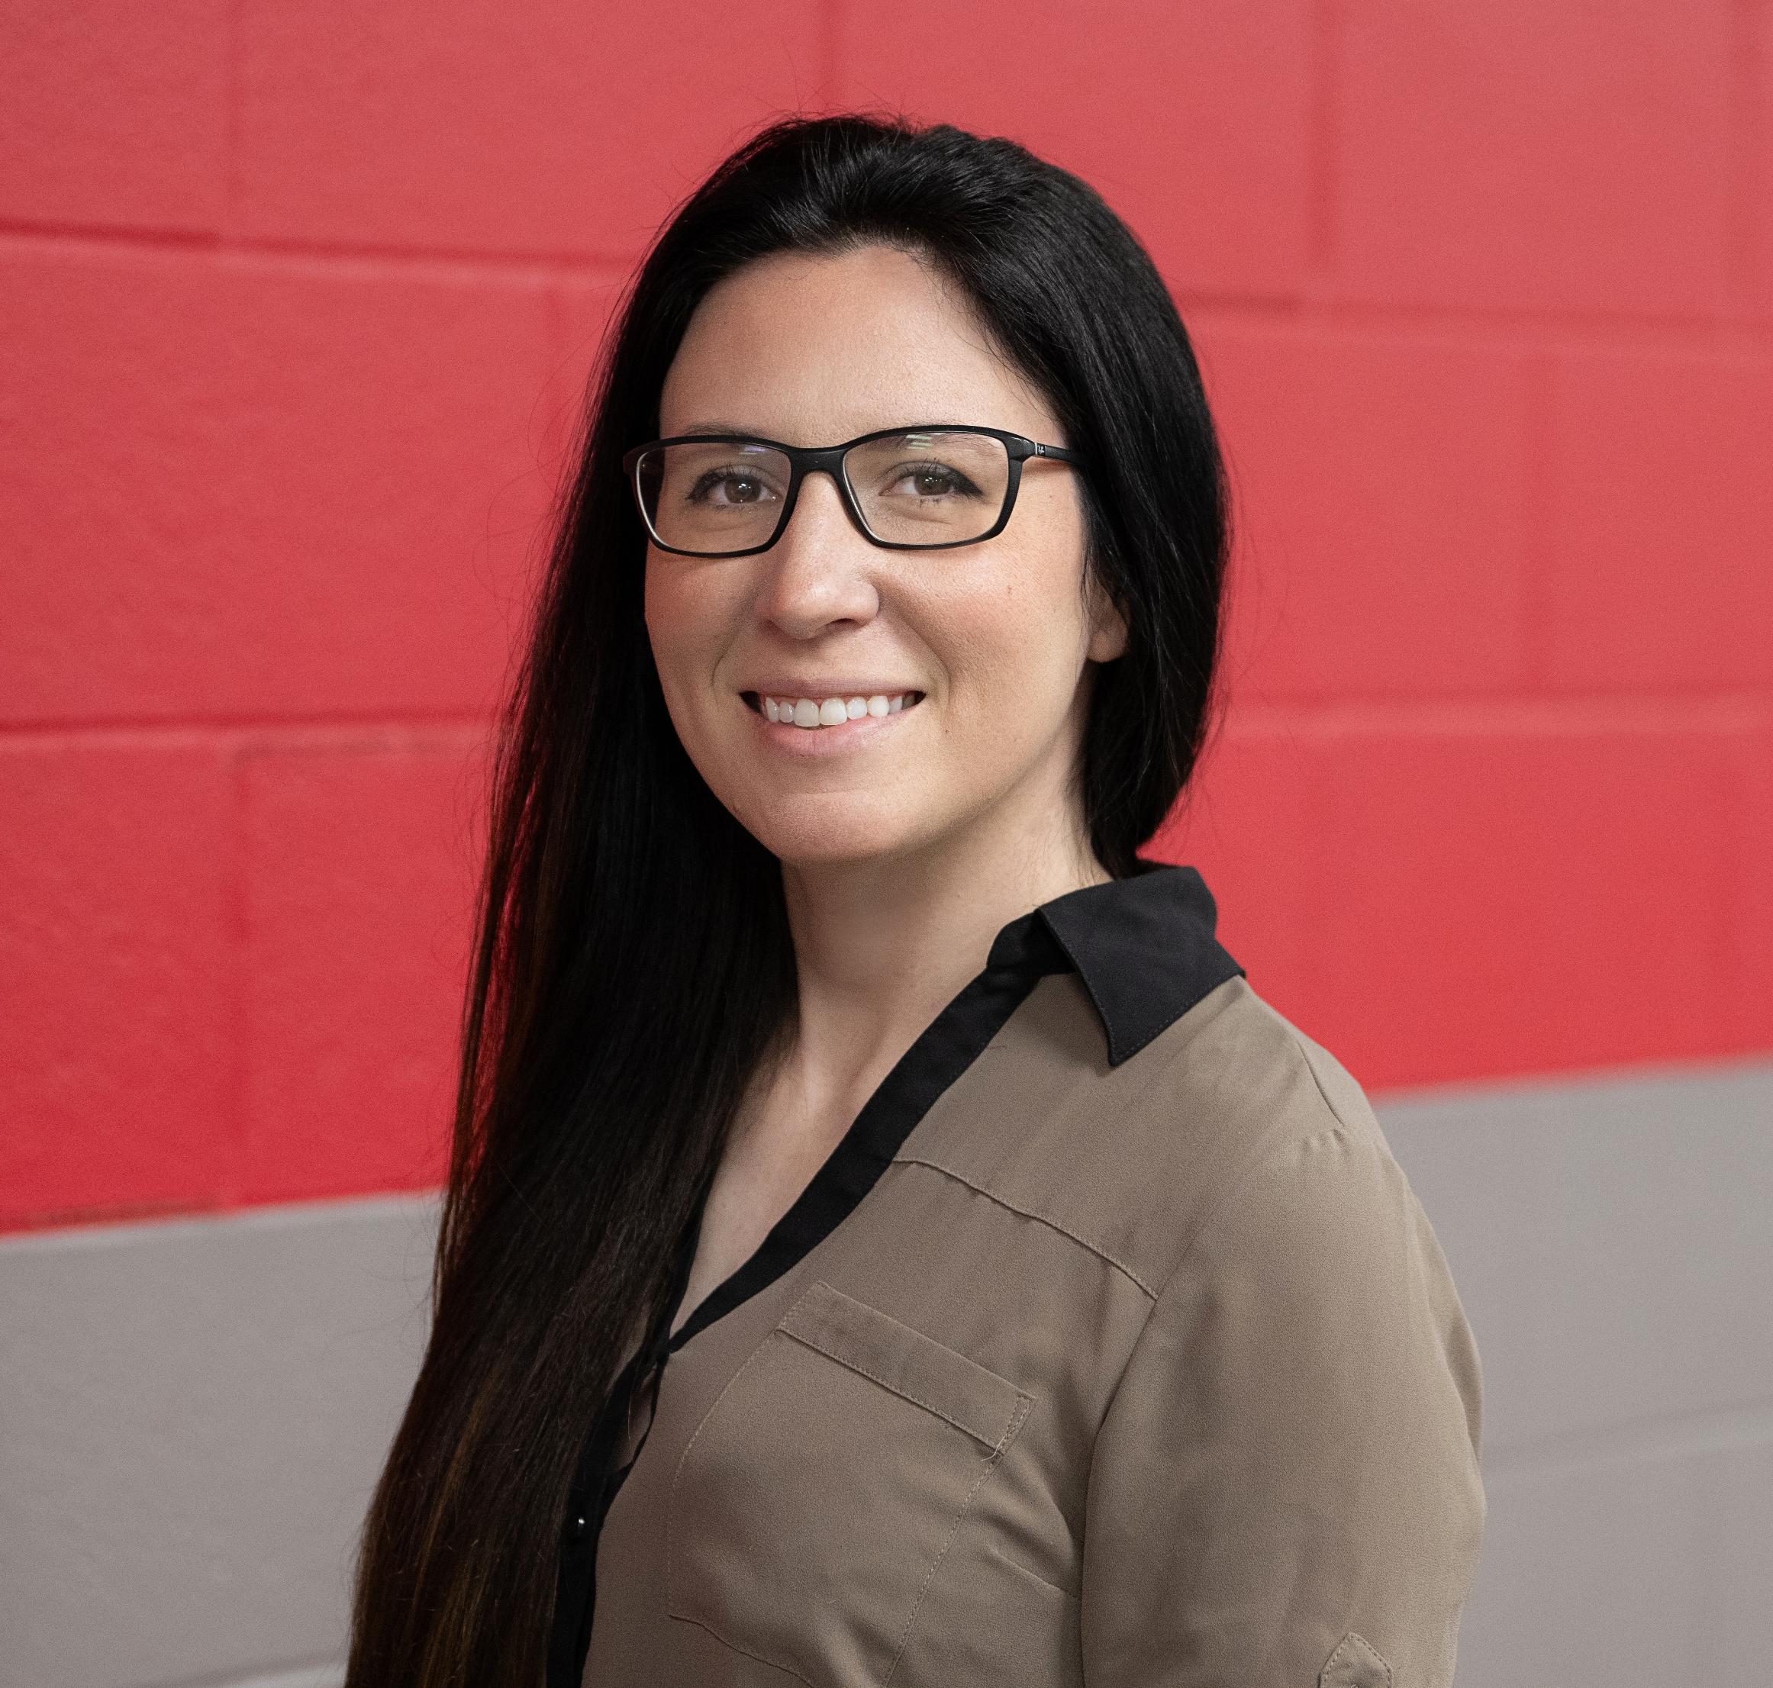
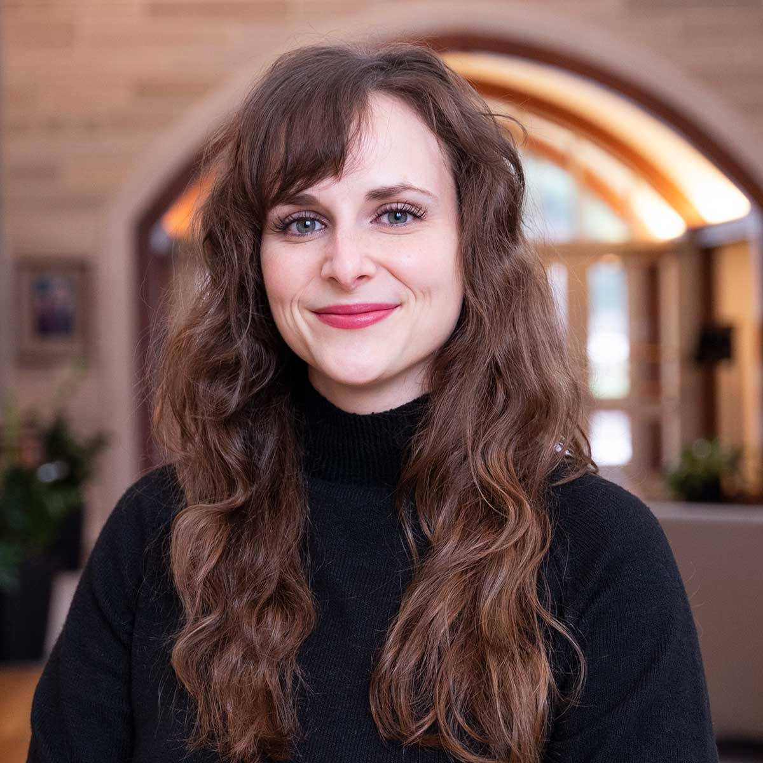
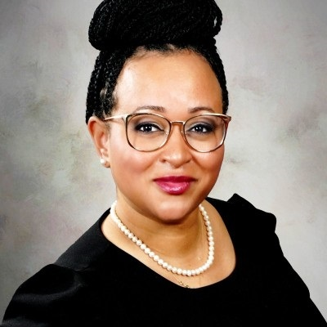
Stewardship Officers
Serve as the single point of contact for an assigned portfolio of advancement CSUs.
Support recognition, stewardship, and engagement of donors.
Enable fundraisers to act with additional consistency and efficacy for donor recognition, stewardship, and engagement
Rachel Barrett
Stewardship Officer
Hannah Hirsch
Manager, Stewardship Officers
Morgan Hicks
Stewardship Officer
LáLakesha Holmes-Allen
Stewardship Officer

Slide 11
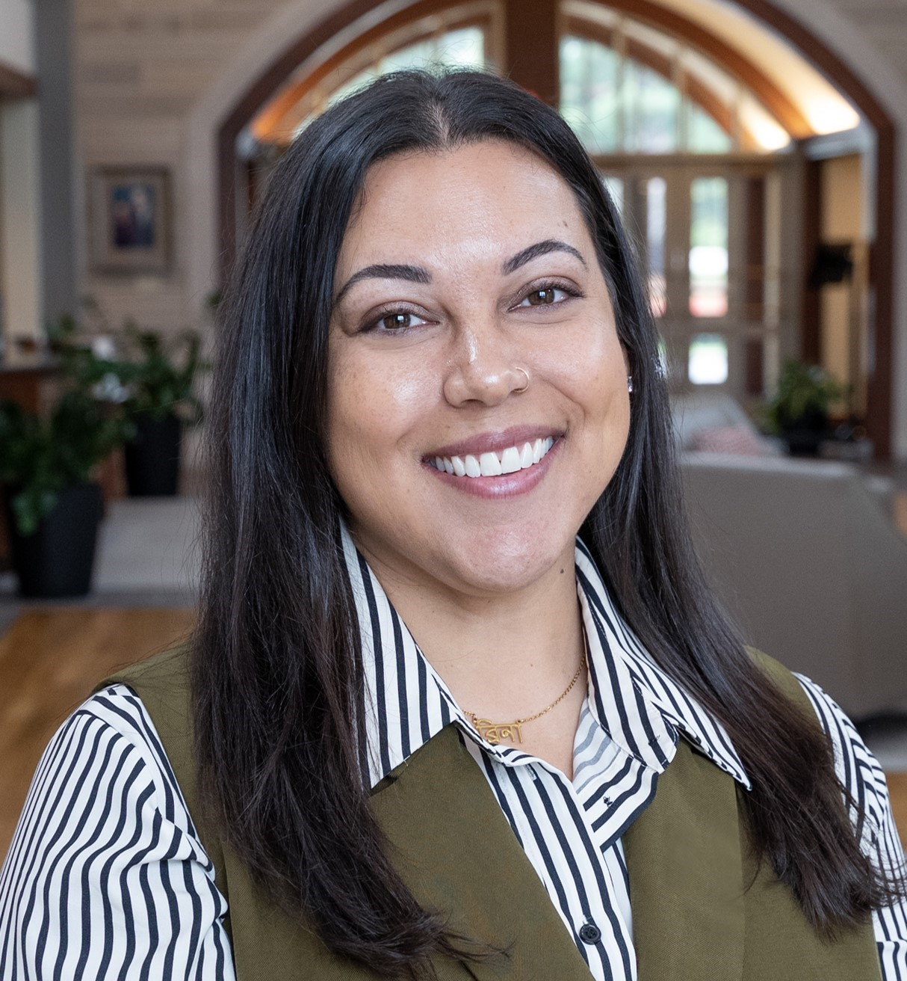
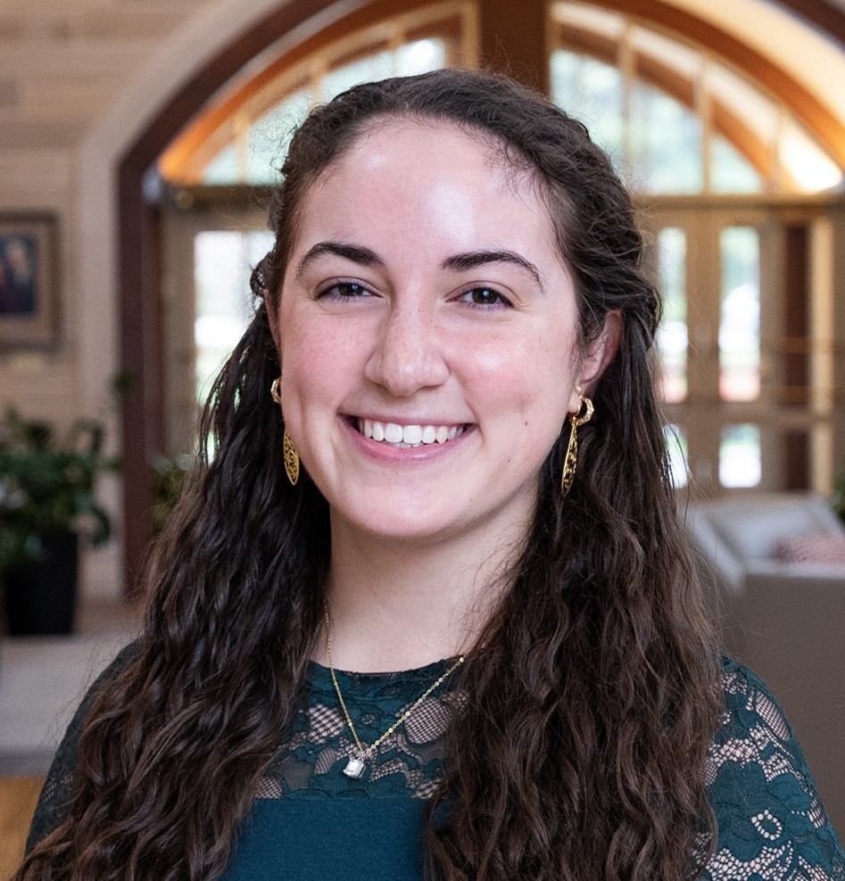
Principal and Transformational Donor Relations
Partnership with Principal and Transformational giving team
Long-term VIP stewardship plans
Custom gifts and donor experiences
Enhanced fund reporting
Partners in Philanthropy event
Stewardship microsites
Presidential briefings
Brina Moore
Manager, Principal & Transformational
Donor Relations
Olivia Rosario Hoover
Stewardship Officer,
Principal & Transformational Gifts

Slide 12
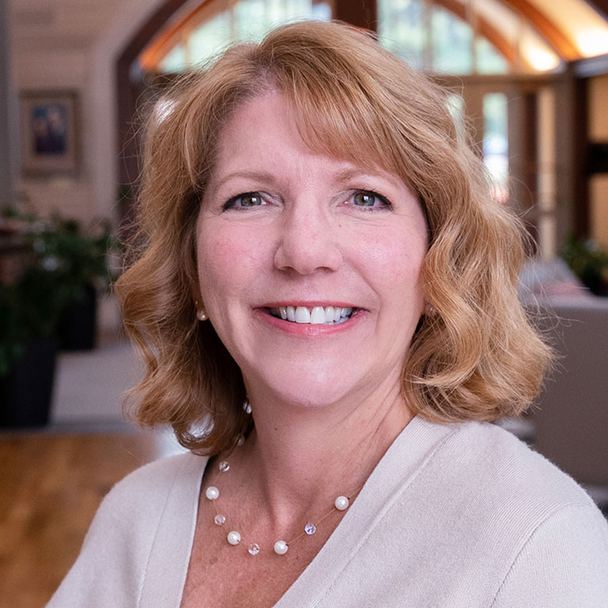
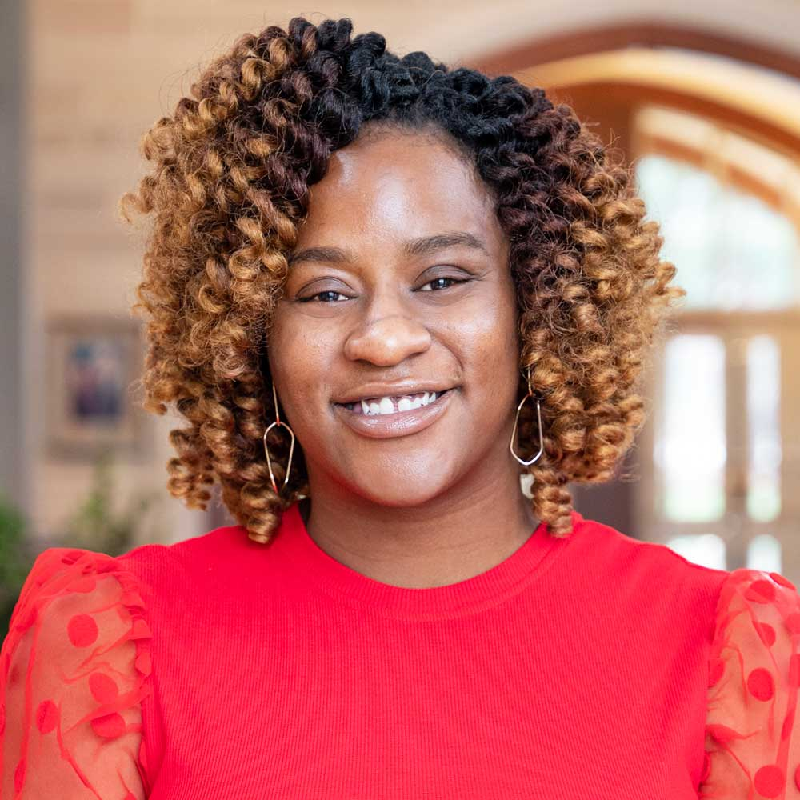
Donor Recognition
Presidents Circle Induction & Laurel Pin Conferral
Football and Basketball suite management
Athletic and Cultural Tickets
Creative and custom gifts for donors
Hotel and lodging reservations
Flowers and cards
Custom ThankView messages
IUF President’s Medallion
Christian Bowling
Donor Recognition Associate
Shelley Bowlen
Manager, Donor Recognition
Shay Porter
Donor Recognition Associate

Slide 13
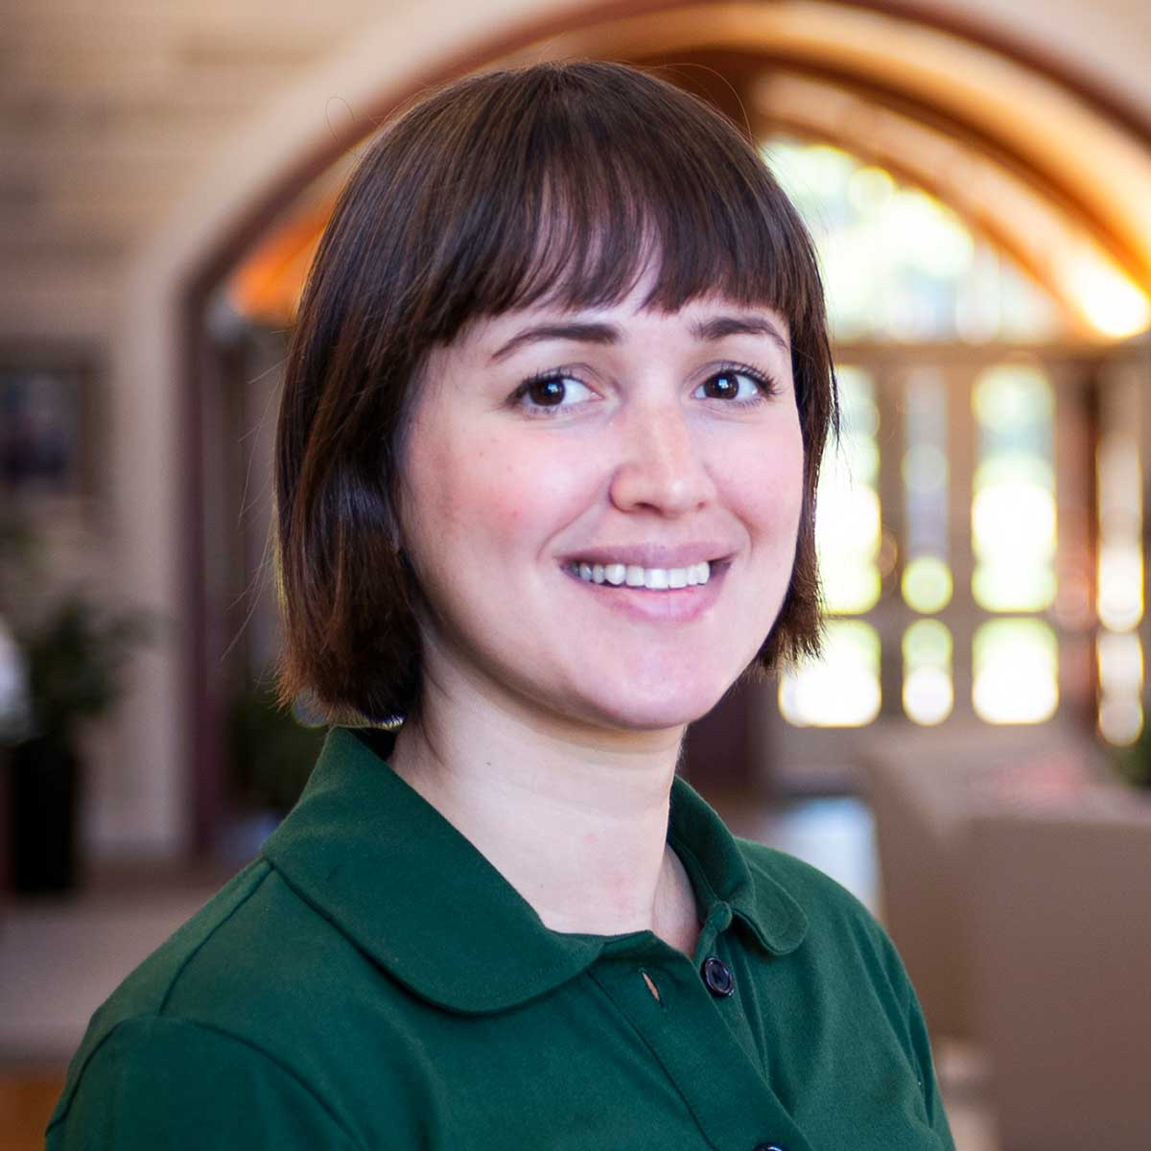
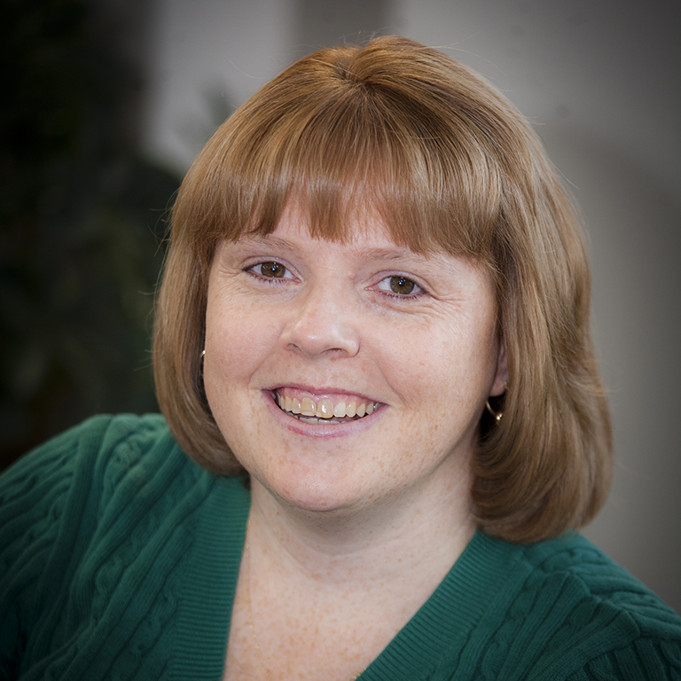
Acknowledgements & Fund Reporting
Fund Reporting:
Annual retrospective financial and impact reports for donors with established funds at IUF
Fund reports sent to donors in October
Initial list of fund report recipients shared in April
Natalie Levin
Acknowledgement Specialist
Ann Bunjan
Manager, Acknowledgements
and Reporting
Penny Messel-Jeffries
Fund Reporting Data Specialist

Slide 14
Confirmations
On January 1st, 2024, IUF changed to an annual receipt
However, every gift receives a confirmation including a thank you from IUF president, amount, designation, and an explanation of the receipt change
Confirmation are sent via email where available
Digital go out immediately after processing, mail confirmations will be sent out 3 times a week

Slide 15
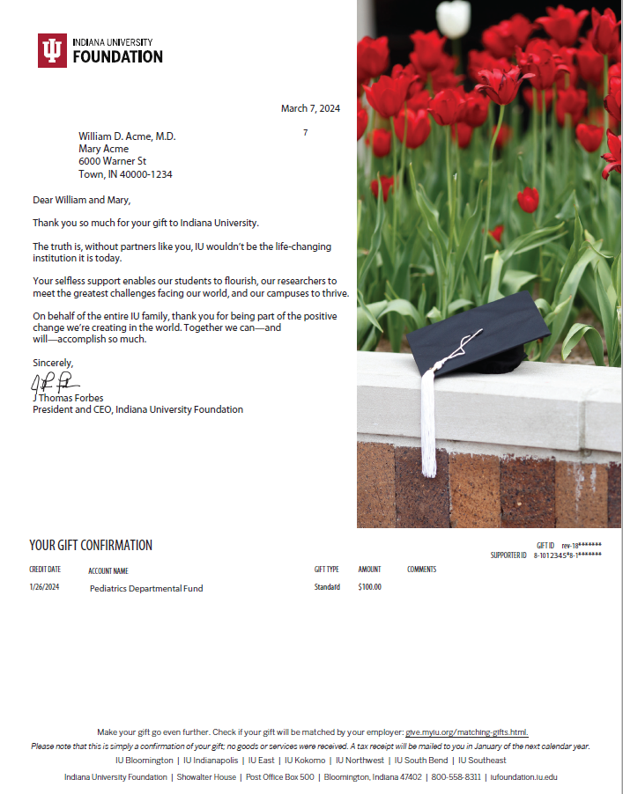
Thank you message from IUF president
Gift designation and amount
Confirmation language

Slide 16
Acknowledgements
Standard letter for $10K+ individuals, DAFs, and corporations (IUF President)
Customized and personalized letters for $100K+ and VIPs (IUF President)
Customized and personalized letters for $500K+ and VIPs (IU President)
Honorarium and Memorial gift notifications
Presidential congratulations and condolences for VIPs
Nearly 9,000 acknowledgements sent in 2023

Slide 17
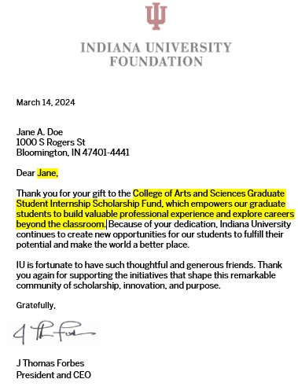
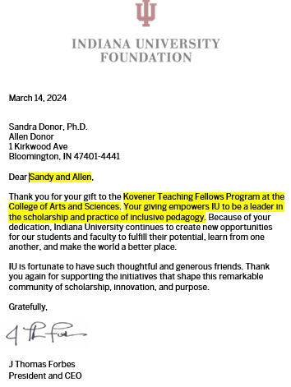

Slide 18
Questions?
Feel free to send any further questions to Rachel Barrett at barrerae@iu.edu

Slide 19
Balancing Scale and Personalization
We prioritize personal connections with our donors. The more personalized their experience, the deeper their connection to the College.
Our stewardship, gift acknowledgment, and donor recognition initiatives are meticulously crafted to address the challenges posed by the College's significant scale while maximizing personalization and segmentation.
In a typical year, the College Advancement Office:
Sends 3,000(+) donor gift acknowledgments.
Mails over 620(+) donor packets, which include scholarship and fellowship recipient names, cover letters, and recipient acknowledgment letters.
Mails over 850(+) recipient letters to donors.
(Note: **These numbers are subject to change with the new processes being implemented this year.)

Slide 20
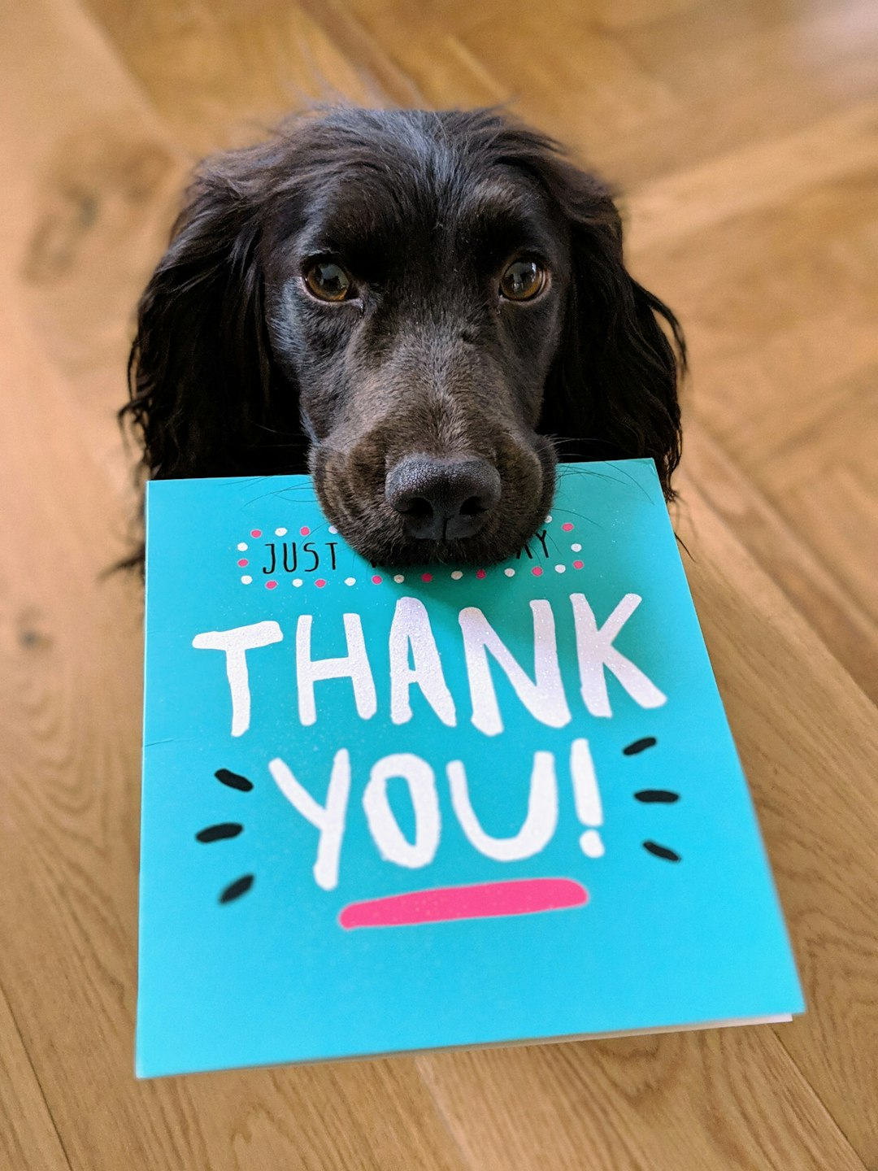
Tailored Acknowledgment: Segmentation Strategies
College segments include:
General Unrestricted Fund
General Scholarship Fund
Experiential Learning Fund
College Faculty/Staff
In Honor of /In Memory of
Recurring/Payroll Deduction (sent in July and January only)
Executive Dean’s Advisory Board
First Time Donors
Department/Program segments include:
In Honor of /In Memory of
Recurring/Payroll Deduction
We also spotlight any corporate or foundation funds and donors residing outside the country to help your stewardship efforts.

Slide 21
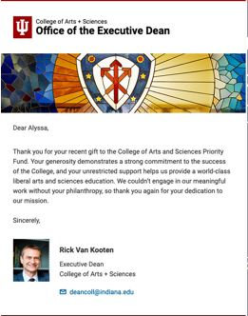
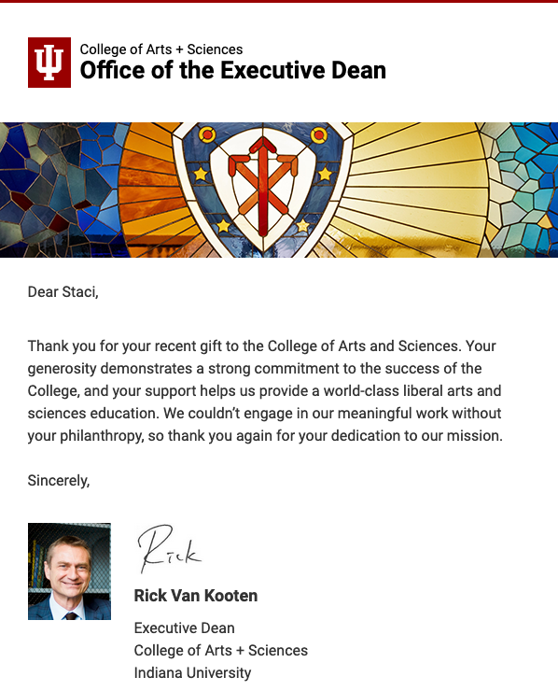
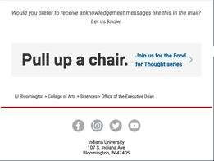
Weekly Digital Acknowledgments ($999 and below)
Sender Name + Branding:
Executive Dean
Personalized salutation
Segmented thank you message
Executive Dean’s signature

Slide 22
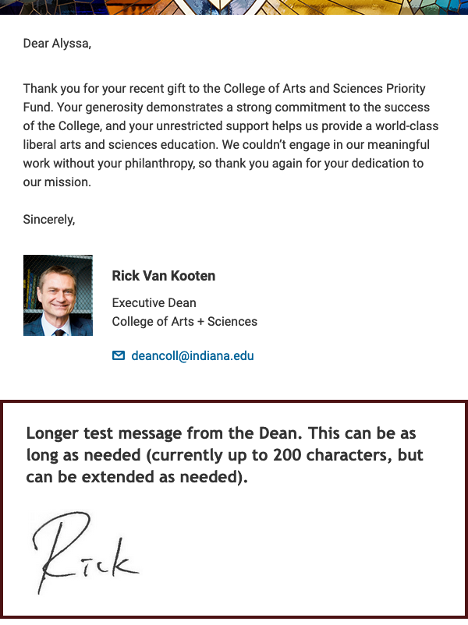
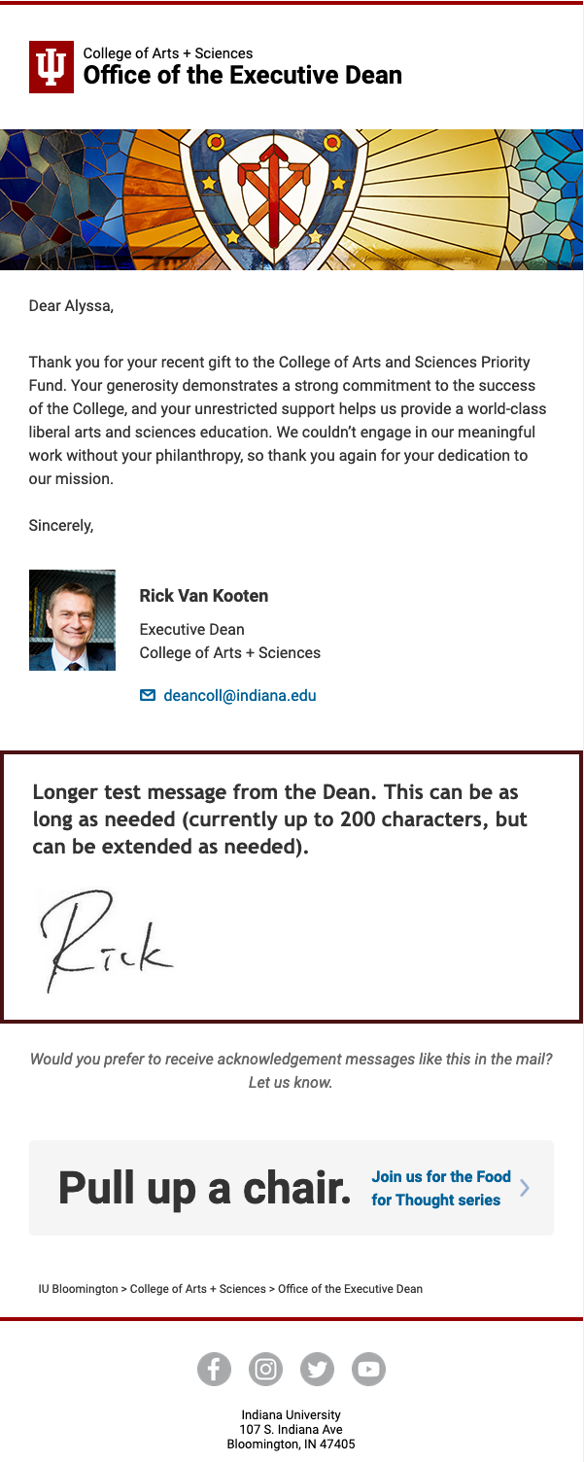
Tailored digital design featuring an optional personalized message from the Executive Dean
Bi-weekly Digital Acknowledgments ($1,000 and above)

Slide 23
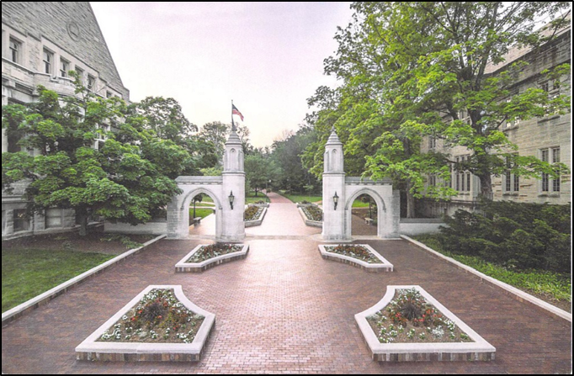
Weekly Acknowledgment Postcard ($999 and below)
Front of postcard
Back of postcard
Segmented thank you message with the Executive Dean’s electronic signature.
A QR code is added to all cards:
“Would you prefer to receive gift acknowledgments like this by e-mail?
Scan the QR code to update your e-mail address and explore the College Community.”

Slide 24
Bi-weekly Acknowledgment Card ($1,000 and above)
Customized Acknowledgment Card:
Hand-signed with an optional personal message from the Executive Dean
A QR code is added to all cards:
“Would you prefer to receive gift acknowledgments like this by e-mail? Scan the QR code to update your e-mail address and explore the College Community.”

Slide 25
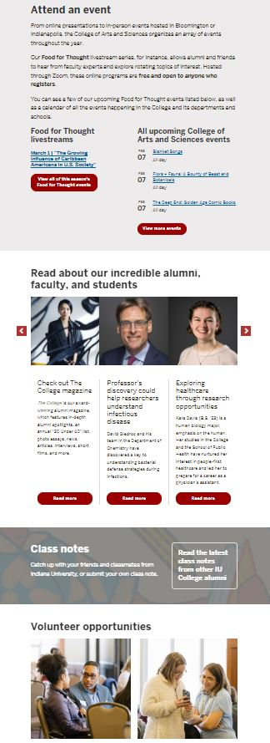
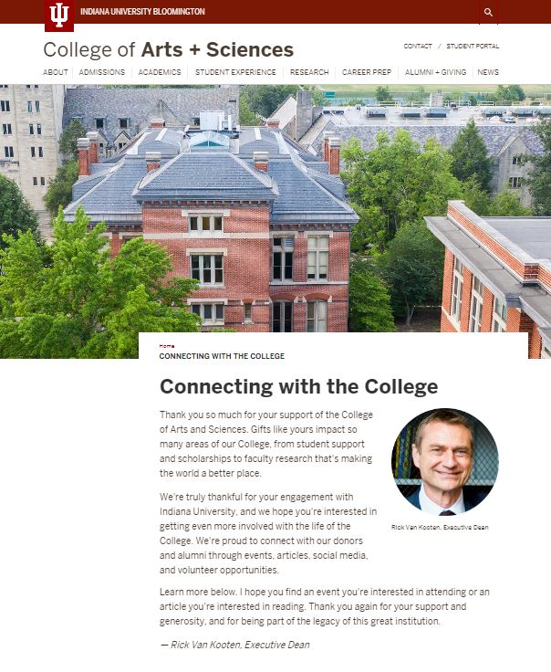
First-Time Donor
College resources
Attend an event
Read about our incredible alumni, faculty, and students
Welcome message from the Executive Dean
Class Notes
Volunteer opportunities

Slide 26
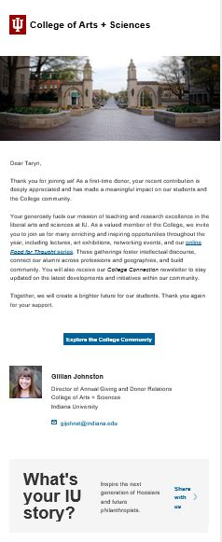
First-Time Donor 30 Day Check-in
Attend an event
New Donor 30-Day Check-in: Acknowledgment by the Director of Annual Giving and Donor Relations
Read about our incredible alumni, faculty, and students
Class Notes
Volunteer opportunities

Slide 27
First-Time Donor 1 Year Anniversary
First-time Donor Anniversary Acknowledgment: Personalized from the Executive Dean
(Note: This initiative is scheduled to commence in July.)

Slide 28
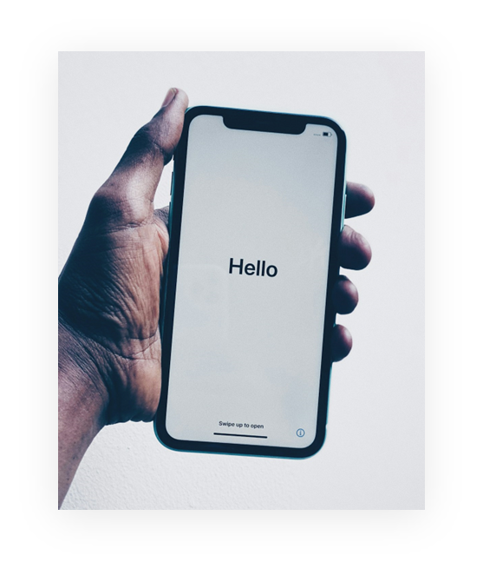
Enhancing Departmental Acknowledgments
1. Regular Personalization:
Implement a strategy for sending personalized acknowledgments consistently.
2. Clear and Concise:
Ensure acknowledgments are direct and personalized to resonate with donors.
3. Refresh Regularly:
Update language and imagery every six months to maintain relevance and impact.
4. Embrace Virtual Platforms:
Utilize virtual channels to expand the reach of gratitude expressions and engage a wider audience.

Slide 29
ENDOWMENT IMPACT REPORTING
Demonstrating the meaningful impact of donor contributions

Slide 30
Scholarship and Fellowship Reporting Timeline
SPRING 2024 AND SUMMER 2024 AWARDS
April – August (Collect all materials)
MAIL REPORTS TO DONORS
Late August
FALL 2024 AND SPRING 2025
August – October (Collect all materials)
MAIL REPORTS TO DONORS
Mid-November
What we need from you:
Recipient names, e-mail, and student ID (Only if they are not loaded into BAM, which may include renewal awards)
Personalized Chair and Director cover letters

Slide 31
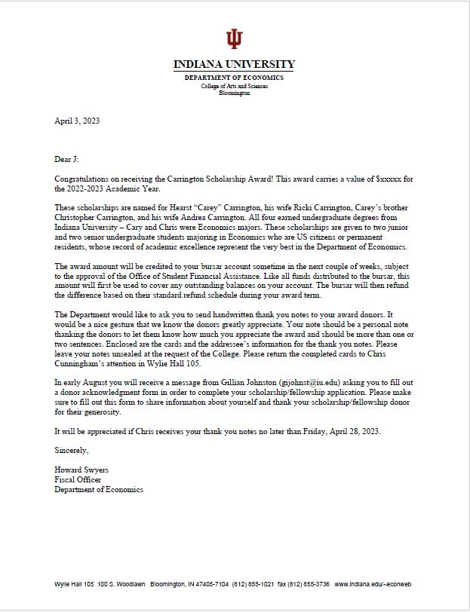
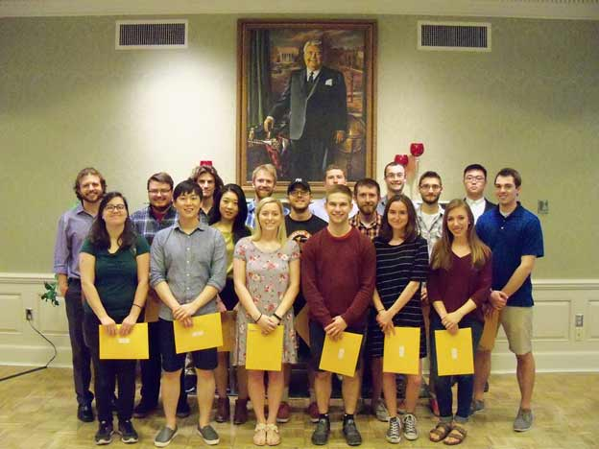
Leading the Way: Department of Economics
Award Letter
Award Ceremony
Award Certificate

Slide 32
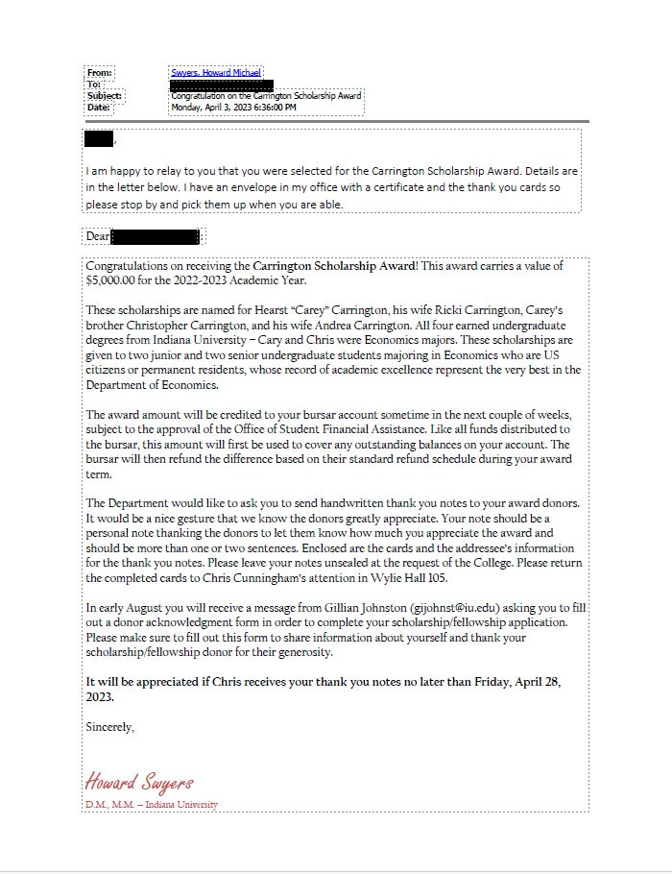
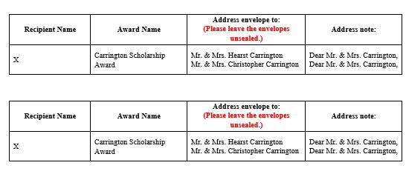
Collecting the Data
Follow up email
Salutation instructions
Enclosed card and envelope

Slide 33
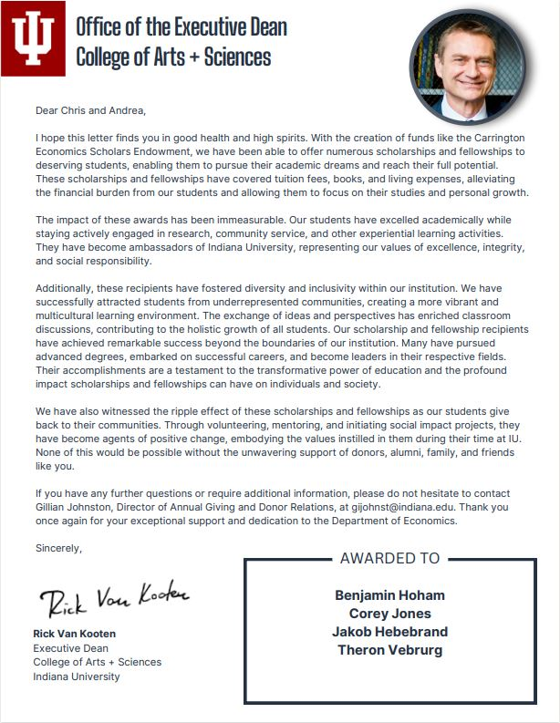
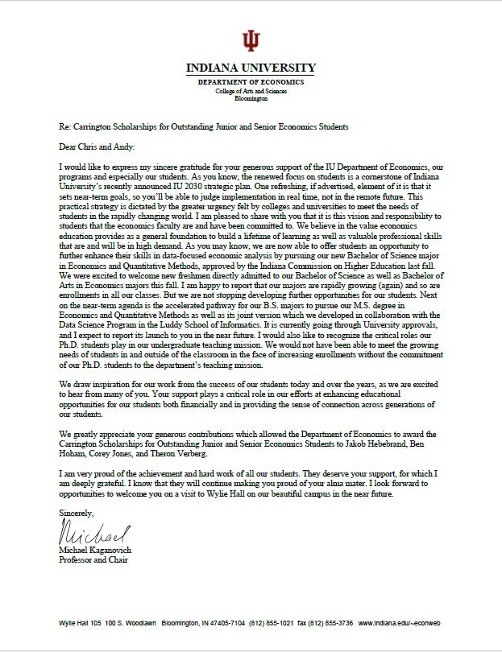
Scholarship and Fellowship Cover Letters
Cover Letter from the Executive Dean
Cover Letter from the Chair/Director

Slide 34
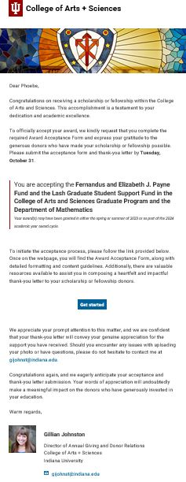
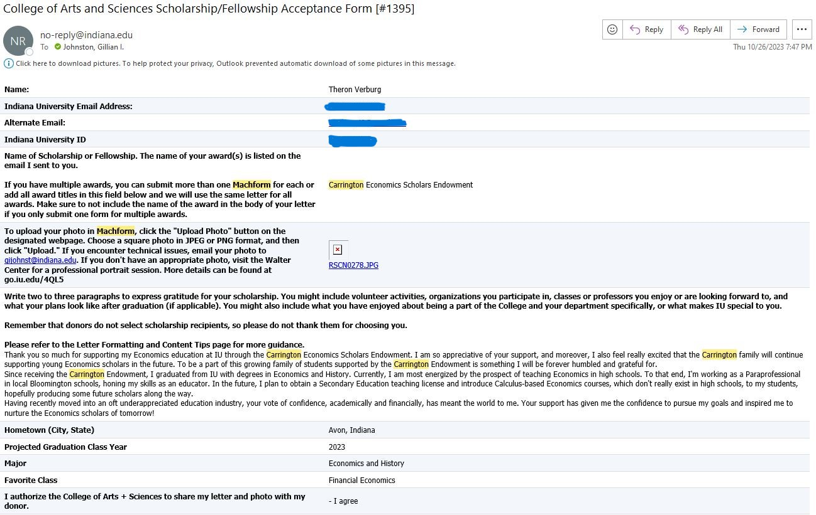
Collecting the Data
Mach Form Output
Each letter is personalized to the recipient
We provide the name of the award(s) they need to acknowledge, as well as the department name to avoid any confusion.
Mach Form link

Slide 35
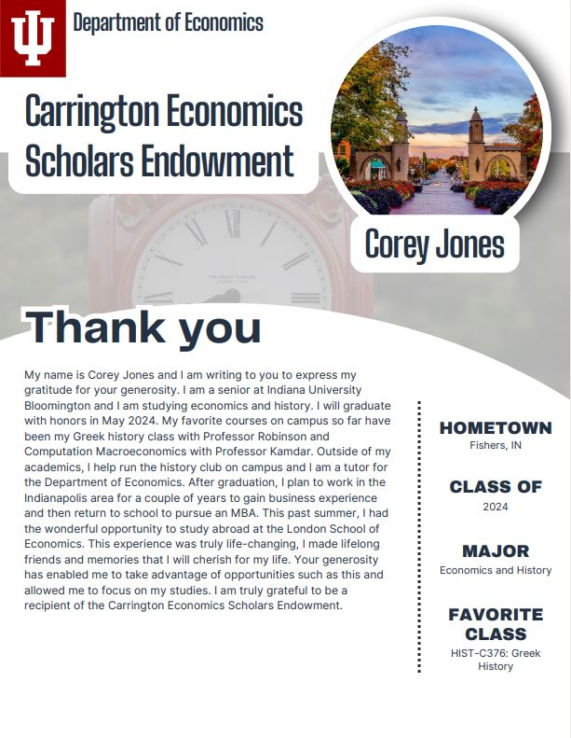
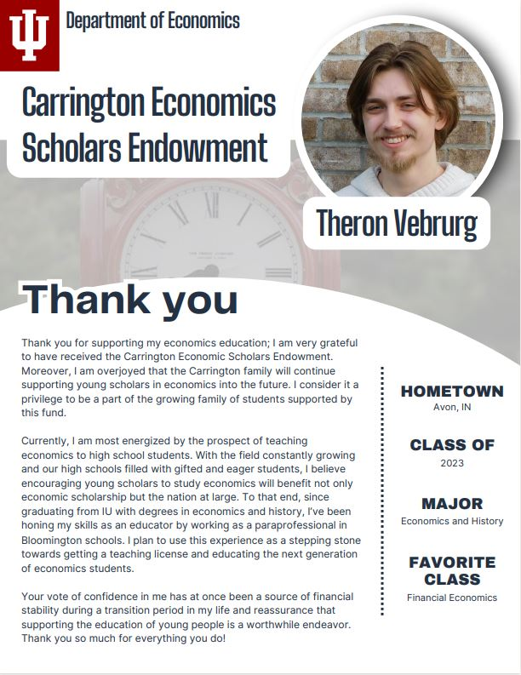
Scholarship and Fellowship Recipient Letters

Slide 36
Scholarship/Fellowship Endowment Best Practices
1. Timely Recipient Information Submission: Ensure recipient information is provided to the Advancement Office by the requested deadlines.
2. Semi-Annual Chair/Director Cover Letters: Submit personalized Chair/Director cover letters twice a year to accompany donor packets.
3. Enhance Donor Relationships:
Reflect on your awarding process to identify opportunities for enhancing donor relationships and engagement.

Slide 37
What questions do you have?

